Slide 1
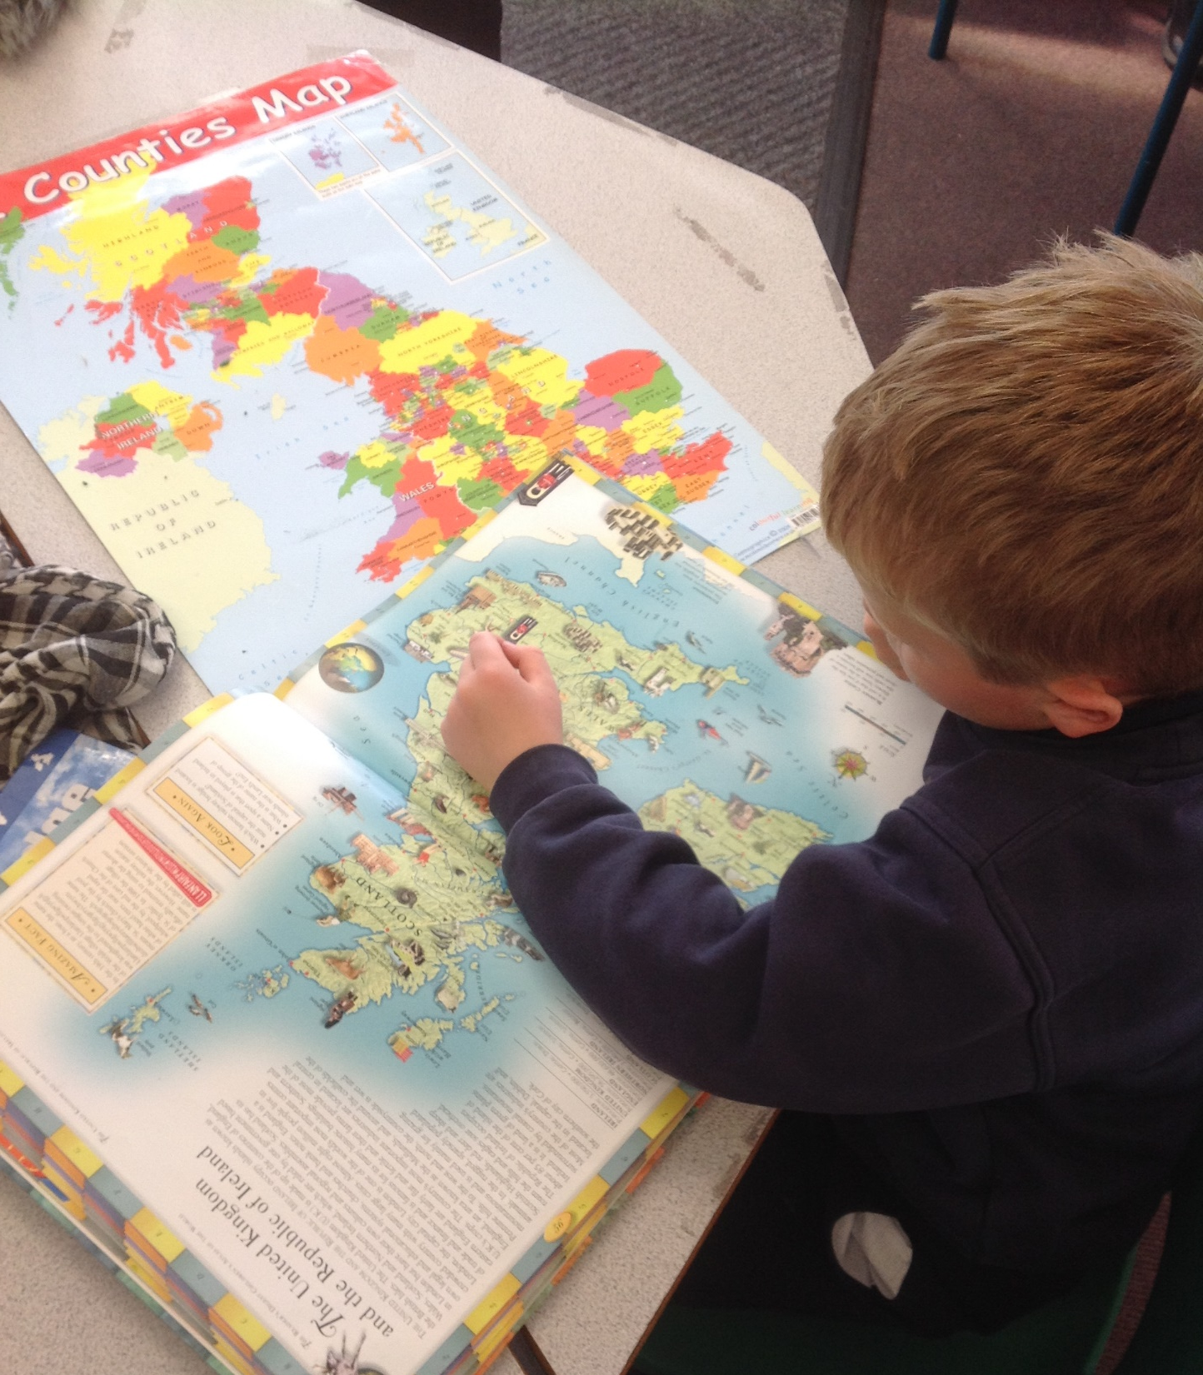
Geography
at
Morda Primary School
Subject Overview
and Plan
May 2022

Slide 2
Intent
At Morda our geography curriculum seeks to inspire pupils to become responsible and courageous local and global citizens. We use Mantle of the Expert fictional contexts as a tool to transport our pupils to the most inaccessible places in the world and also to explore geographical challenges in our own locality.

Slide 3
Implementation
Pupils are taught key physical and human knowledge of the world regularly, in order to embed this information in their long-term memory. Within carefully constructed fictional contexts, pupils visit places of geographical interest and explore and influence geographical challenges as if they were operating in the real world. Our pupils are led by our Christian Values of Courage, Compassion and Fairness as the consider difficult geographical challenges in the world. Through the geography curriculum, they reflect on their own actions and responsibilities to other people, to the environment and to the sustainability of the planet. Our eco -school committee encourages children become responsible eco-citizens and make a positive impact on their local and global environment.
Curriculum Design and Pedagogical Approach
Teachers use the Rolling Planning Frameworks to identify the subject content for each Geography topic for example KS1 African Adventure . Using the Geography Progression in Skills document below along with the National Curriculum Programmes of Study, teachers choose which aspects of the unit to emphasise. Their choices are guided by the character of the class, the needs of different groups in the cohort and by the school’s core values of Compassion, Courage and Fairness. For example when designing the Mantle context for KS1 African adventure teachers chose to focus on issues of fairness, highlighting the inadequate educational facilities in the African village. Through the mantle children were encouraged to work together to build a new school. in KS2 Climate Emergency mantle children were encouraged to show compassion for the areas effected by climate change and make courageous choices in their role as environmental experts. Teachers then produce a knowledge organiser which informs their Mantle of The Expert plan and contains the key knowledge. Mantle of the Expert is the primary pedagogical method for Geography alongside focused teaching using retrieval practice of elements that don’t fall easily into the Mantle plan.

Slide 4
IMPACT
Children leave Morda school with a good understanding of the geography of their own locality and the surrounding areas.
They have a good knowledge of the world continents , countries and sustainability and their role in climate change.
Children are able to use and identify features on a arial, os maps atlases and globes.
They can talk in detail about physical and human features of the countries and location they have studied
They leave Morda with a good understanding of their role as global citizens and the impact they have on sustainability and climate change .

Slide 5
Overview
The design of the geography curriculum
What we are trying to achieve with the geography curriculum
Our aims for the teaching of geography
EYFS Understanding the world at Morda
Schemes of work followed and medium term planning in geography
How geography is taught
How we ensure that subject knowledge is retained
How children progress in History over their time at the school (Remembering that progress is knowing more, remembering more and being able to do more)
How we ensure that pupils with SEND benefit from the curriculum in this subject
Links to other curriculum subjects
Subject resources
What geography teaching looks like in work and in lessons
How we prepare children for the next steps in their learning
How we would look to develop this subject in the future

Slide 6
Our aims for the teaching of geography
To develop inquisitive minds and for children to develop a sense of place across the curriculum
To encourage children to be respectful of the natural world and the earth’s resources
For children to know the impact of human beings on the planet and to support them to play their part as global citizens
For children to be ambitious and prepare them for the next step of their learning in geography

Slide 7
EYFS Understanding the world AT MORDA
At Morda, when children start in Reception they learn about Ourselves during the first term at school. We explore where they live and make maps. Children love drawing maps and this extends to the continuous provision when they make various journey maps in the outdoor area and at Forest School.
During the year, children learn about different countries and where they are in the world.
We read a range of books which take place in different countries and find more about those countries.

Slide 8
Early Learning Goal
At the end of the Reception year, children are assessed against the Early Learning Goals. Children are assessed as expected or emerging. Understanding the world: People, culture and communities covers Geography.
This information is shared with parents and year 1 teachers so they understand the child’s stage of development and learning needs and help them to plan the year 1 curriculum to meet the needs of all children.
People Culture and Communities ELG
Children at the expected level of development will:
Describe their immediate environment using knowledge from observation, discussion, stories, non-fiction texts, and maps;
- Know some similarities and differences between different religious and cultural communities in this country, drawing on their experiences and what has been read in class;
- Explain some similarities and differences between life in this country and life in other countries, drawing on knowledge from stories, non-fiction texts and – when appropriate – maps.

Slide 9
The design of the geography curriculum
Planning follows National Curriculum
Two-year rolling programme in operation for geography in KS1 and KS2
The rolling programme ensures the following:
Match with two-year rolling programme for other subjects to provide cross-curricular links
Sufficient and cumulative coverage of the national curriculum components that develops knowledge over time (regardless of theme)
Components are tracked to ensure key components are taught and repeated throughout rolling programme – a ‘spiralling’ curriculum
Match to specific needs of learners at Morda, reflecting needs and characteristics of learners
Prevention of duplication of content due to fluctuation in year group sizes whilst enabling sufficient coverage and revisiting of concepts
Termly theme blocked to provide opportunities for deep learning of a subject/unit.
Strand tracker is audited against NC, which reflects content selection to match school context (cross-referenced to school drivers) and need, and demonstrates cross-curricular links
Link with history as a humanities-based topic, but underpinned by clear geography learning objectives and concepts. For instance, a history based unit will still maintain and build opportunities for children to develop their geographical knowledge within any topic

Slide 10
How geography is planned
Progression of knowledge document identifies the knowledge and skills to be remembered during the unit of work
All of this is then encompassed within the Knowledge Organiser

Slide 11
What we are trying to achieve with the geography curriculum
School has set out knowledge and skills to be learnt within geography
Working as a geographer
using maps, atlases, globes and digital mapping, using locational and directional language, using aerial photographs, devising maps, using Ordnance Survey maps and fieldwork
Development of specific components of geographical knowledge

Slide 12
Concepts to be remembered (and revisited to develop deep understanding)
School has set out components for children to learn and develop through Geography
These deliberately repeat across units (See knowledge and skills progression document)
See two year rolling programme to see how components track across units
Weather and Climate
Processes
Land use
Agriculture
Trade
Settlements (city/town/village)
Environment
Resources
Population
Immigration/Migration
Rural
Urban
Economy
Pollution
Sustainability
Physical
Human
Fieldwork
Landmarks
Features
Seas and oceans
Continents
Country

Slide 13
Schemes of work followed and medium term planning in geography
The school does not use a commercial scheme of work; sequences of learning are developed to ensure
Children develop sufficient knowledge within the 4 class structure
The National Curriculum is taught
Children’s learning reflects their local context
This translates to knowledge organisers which is informed by the progression of knowledge and skills document
These are used as a tool for teachers planning and sets out a clear sequence of specific content to be taught and remembered

Slide 14
How we ensure that subject knowledge is retained?
Operation of rolling programme plans for deliberate return to key concepts
Use of opportunities for routine retrieval practice within classrooms
Regular formative assessment opportunities to adapt learning during a unit of work
Mind map of knowledge learnt at the end of each unit

Slide 15
Assessing knowledge including use of Proof of Progress tasks
Use of formative assessment to adapt teaching
Strengthening metacognition through self-assessment tasks and retrieval practice
Peer-assessment
Feedback and adaptation of teaching to address misconceptions and strengthen understanding
Regular fact five sessions
Use of quizzing, Hinge questions and Exit passes
The school has introduced pre and post mind maps and at a distance pupil interviews designed to…
Provide an opportunity for children to engage in retrieval practice
Identify key gaps in knowledge to be addressed in future teaching
Be used to refine planning and improving the unit of work for the future
Assess what knowledge has been retained

Slide 16
How we ensure that pupils with SEND benefit from the curriculum in geography
Pupils with special educational needs and/or disabilities are fully included in the provision for geography
Teachers and other adults support pupils well so that they can access the same content
Some children may receive pre-teaching to cover key vocabulary prior to the lesson
Post-teaching support may provide opportunities for review to embed understanding
Children are not taking part in interventions for geography and attend the full curriculum offer

Slide 17
Links to other curriculum subjects
Knowledge to be remembered in geography is discrete but is often taught in context of other subjects.
Some units may have more or less geographical concepts but the regular repetition of components ensures for regular repetition and deep understanding
History/RE/Art (a sense of place)
PE (orienteering)
Mathematics (data handling, bearing and compass work)
Art (landscapes)

Slide 18
Subject resources
School does not follow a published scheme for geography
School has a poor/old collection of resources for geography - the subject has not been well resourced in the past with teachers needing to find/make their own resources. However, new atlases have been purchased and use of digi maps to support in map work. An audit of resources to be completed Spring 2022.
Use of the Shropshire Library Service is utilised for extra resources for specific units
Use is made of online resources and mapping on IWBs (Google Earth, Ordnance Survey online, Etc.)

Slide 19
Curriculum enrichment
The geography curriculum is enriched through educational visits to support children’s knowledge of geography
This includes
Visits to other contrasting localities (Liverpool)
Fieldwork in local area Walk of local area, visit to Hill Fort in Oswestry)
To include visitors in to school to enhance learning

Slide 20
What geography teaching looks like in work and in lessons
Geography is included within the regular cycle of monitoring
This monitors outcomes in children work, reviews planning and considers impact of assessment, practice and feedback – the last review was in Spring 2020
Governors lead ‘pupil voice’ activities to provide opportunity for children to reflect on their learning experiences
Link governors liaise with subject leaders to review curriculum developments and support evaluation

Slide 21
Preparing children for the next steps
Most children transfer to Mary Webb School at end of Y6
Discussions with Mary Webb planned Autumn term 2021
Aim to provide precision with which primary schools set their curriculum goals and make sure pupils are properly prepared for the next phase of education

Slide 22
Staff CPD & Research
School has developed the Geography curriculum and knowledge of skills using the Di Pie training
Geography subject leader to arrange working with other subject leaders to develop Geography progression in Morda school (Summer 2022)
Subject lead to arrange team teaching in other classes to find out how learning takes place across the school.

Slide 23
How will this subject develop in the future?
Need to undertake monitoring of the subject in Summer 2022 and report to governors.
Need to ensure resource audit
Where are the resource frustrations? What do we need to be able to teach it better?
How can we support children’s geographical knowledge in other areas of the curriculum (and do we have the resources to support this)?

