Slide 1

Writing
Subject Overview and Plan
Last updated – Dec 2025

Slide 2
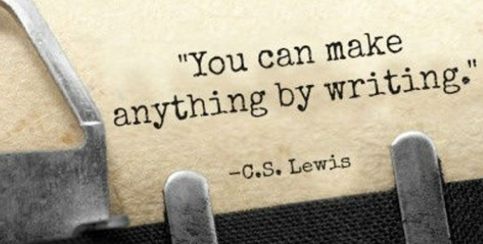
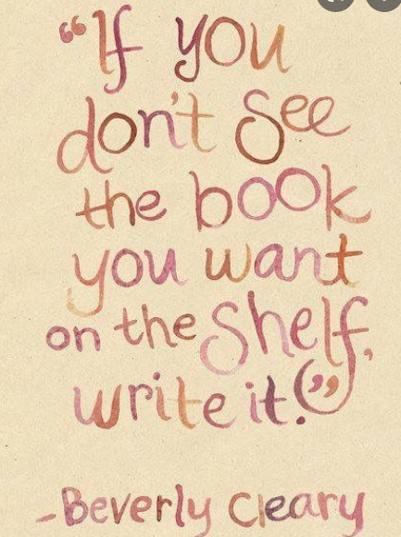
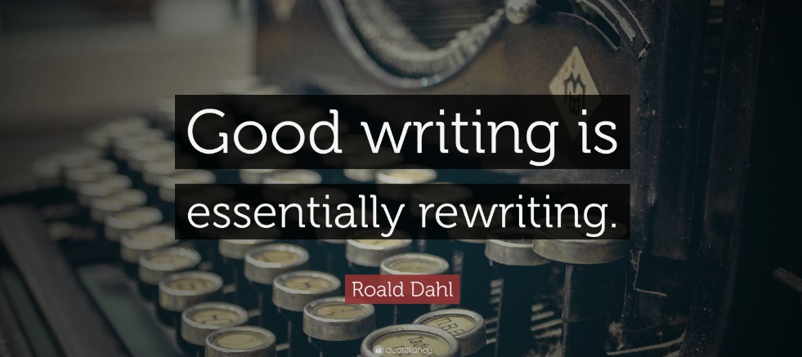

Slide 3
Overview
Our Vision for Writing ( Intent/ Implementation and Impact )
What we are trying to achieve with the writing curriculum
Our aims for the teaching of writing
Schemes of work followed and medium term planning in writing
How writing is taught
How we ensure that subject knowledge is retained
How children progress in writing over their time at the school (Remembering that progress is knowing more, remembering more and being able to do more)
How we ensure that pupils with SEND benefit from the curriculum in this subject
Links to other curriculum subjects
Subject resources
What writing teaching looks like in work and in lessons
How we prepare children for the next steps in their learning
Staff CPD and Research
How we would look to develop this subject in the future

Slide 4
MORDA VISION FOR WRITING
INTENT :
At Morda, our vision for writing is that all pupils develop the voice to communicate their thoughts and feelings confidently, both vocally and in the written form. We strive to give children the knowledge and skills to become competent writers and the enthusiasm to enjoy creating text in all its forms.

Slide 5
IMPLEMENTATION:
Early talk is the critical first port of call on children’s writing journey. By sharing wonderful stories from brilliant authors from day one at Morda, we are teaching children to imagine: especially those pupils with speech and language issues or other disadvantages.
From EYFS through to lower KS2 children are taught writing chiefly through the Pie Corbett ‘ Talk for Writing’ approach. They are immersed in well known stories that they learn and love. Teachers create clear sequences of learning to teach a particular text types. They choose high quality engaging published texts ( fiction , non fiction and poetry) or write their own engaging age appropriate exemplars. Children engage with texts through drama and roleplay. They learn texts and internalise the language structures needed to write through ‘talking and performing the text’, moving from imitation to innovation to independent application in their writing .
As children move through the school pupils are taught more challenging sentence structures in line with NC year group expectations. They learn and use the features or a wide range of writing genres and practise writing in these genres. At Morda, we teach sentence structure ‘Alan Peat Sentence structures’ which are are designed to help children to write exciting, sophisticated pieces of writing that use the right tone for their purpose.
Pupils are supported through a carefully structured sequences of learning. They develop their vocabulary and author voice through engaging with and analysing high quality texts and exemplars. Children with SEND are supported in their writing with specific interventions ( e.g. Talk Book and Conquering Literacy –Dyslexia support)
Mantle of the Expert drama techniques are used to enrich writing. Pupils work within fictional contexts, pupils explore written and spoken language and express themselves in a range of linguistic registers, well beyond their lived experience. They speak and write using the authorial voice of the characters they represent.
Working within an imagined ‘commission’ context provides the children with an urgent ‘ real’ ( within the drama ) need to write and the confidence to make use of the wide vocabulary they have encountered through the larger fictional narrative .
Pupils are taught phonics, spelling patterns, punctuation, grammar and sentence structures systematically in a spiral curriculum through the school. They learn the conventions of how to construct a range of formal and informal writing genres.
​Pupils are taught handwriting systematically through school beginning with mark making and pre-cursive writing in year 1 and developing joined handwriting using the Nelson handwriting scheme throughout school Nelson Pre cursive Year 1 and spelling is taught using the Oxford Owl Spelling scheme.

Slide 6
IMPACT
At Morda, pupils become courageous in their writing- they learn not to fear the empty page. They learn that the writing can be a beautiful form of artistic expression and a powerful tool for change.
Morda pupil’s writing is purposeful and often compelling. Pupils enjoy of the richness of the English language. Morda pupils to become capable and enthusiastic writers who genuinely enjoy writing and reflect on and improve their own other’s work.

Slide 7
Our aims for the teaching of writing
For children to develop their procedural and substantive knowledge in relation to primary writing in order for them to make progress by knowing more, remembering more and being able to do more
To develop inquisitive minds and instil children with a sense of awe and wonderment in relation to writing
To encourage children to be respectful of writing
For children to know the impact of writing and encourage them to play their role as global citizens
For children to be ambitious and prepare them for the next step of their learning in writing
For children to be resilient in seeking improvement and overcoming challenges in writing

Slide 8
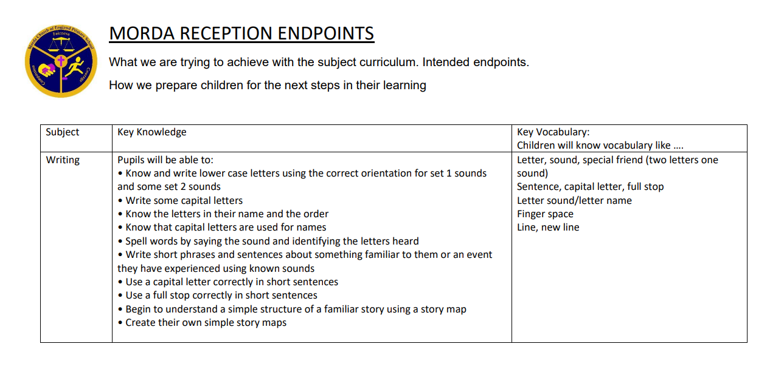

Slide 9
Development of the approach to writing
Writing at Morda has developed over a number of years. The school has accessed high quality CPD and this has been refined and developed to lead to the development of our very own ‘Morda Writing Pedagogy’
The school has supported Local Authority moderation and used this experience to develop and refine procedures and pedagogy( Writing Lead Helen Chapman has been a County Moderator)
The pedagogy is developed influenced by the work of
Pie Corbetts’ Talk 4 Writing: EYFS/ KS1 use talk for writing techniques – learn age appropriate stories / texts using story mapping and boxing up techniques then imitate, innovate and finally apply their knowledge of the text type independently when writing in a particular genre
KS 2 children are taught a carefully structured spiral curriculum to build their schema for different genres of writing using inspiring high quality exemplar texts, modelled writing and shared writing
Alan Peat Sentence Structures: Alongside the formal teaching of grammatical and punctuation rules and sentence structures children are taught age appropriate ‘Alan Peat’ (see Alan Peat Sentence Types progression document) sentence types are taught from years 2-6 to help children improve their sentence construction and encourage children to use increasingly complex sentence structures.
Jane Constantine – Write stuff teaching techniques including ‘sentence stacking’ have been incorporated into the writing pedagogy to so teachers teach the process of writing more overtly and all children can make progress within the lesson ( from Oct 2022)
Success criteria for pieces of writing are used to support children in constructing their writing and in self and peer assessment.

Slide 10
The planning of writing
Teaching staff are to plan a unit of work, generally over a period of 2-4 weeks.
This provides for a sequence of lessons using the school’s English Pedagogy which has been developed by the school. Planning supports children’s acquisition of knowledge in line with the Morda Writing Assessment
At Morda are writing is often inspired by our Humanities focused Mantle of the Expert Commissions – and children learn to write for an important ‘real’ purpose within the fictional context. Writing is also inspired by high quality fiction and non-fiction texts and throughout the school children learn to write with increasing skill in a range of genres .
Writing genres are selected using the Morda Writing Genres document and agreed with the Writing subject leaders in a pre-planning, planning meeting to ensure the national curriculum is adhered to but also children are taught the full selection of fiction and non-fiction text types by the end of Primary School.
The writing curriculum is deliberately spiral so that children revisit and improve on their ability to write in different genres and styles over time.

Slide 11
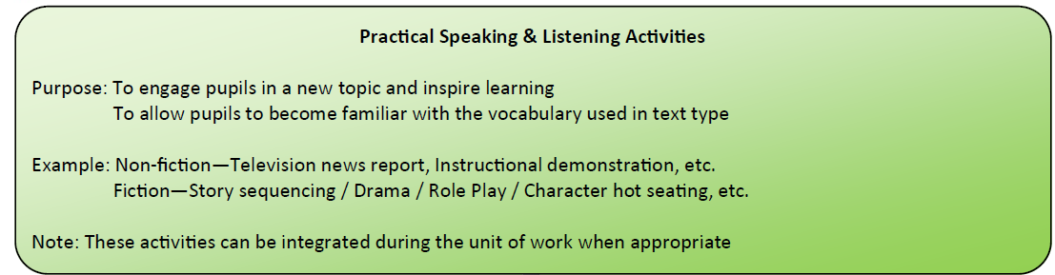
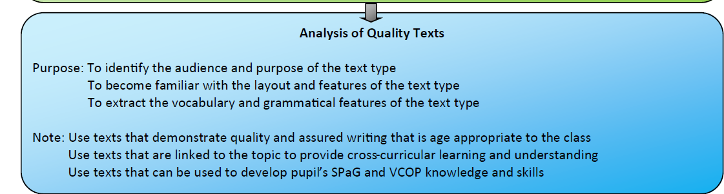
MORDA Writing Pedagogy
Writing units should include a clear sequence of lessons that allows children to gain the key knowledge and skills to be able to write a particular text type.
The pedagogy allows for clear progression.
Pie Corbett Talk For Writing and Mantle of the Expert dramatic contexts provide rich opportunities for children to develop their oracy and author voice.

Slide 12
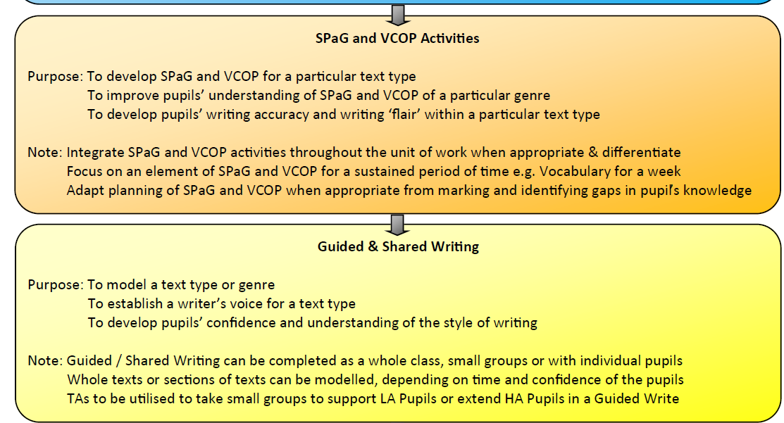
Morda Writing Pedagogy
Teachers integrate teaching of grammar and punctuation into their sequence of learning in Reception KS1 and KS2
Year 6 are taught grammar and punctuation more formally as part of their preparation for end of key stage assessment and secondary transition.
RWI Oxford Owl Spelling programme taught in years 2-6
Modelled, guided and shared writing is used where appropriate to support and extend children’s writing.

Slide 13
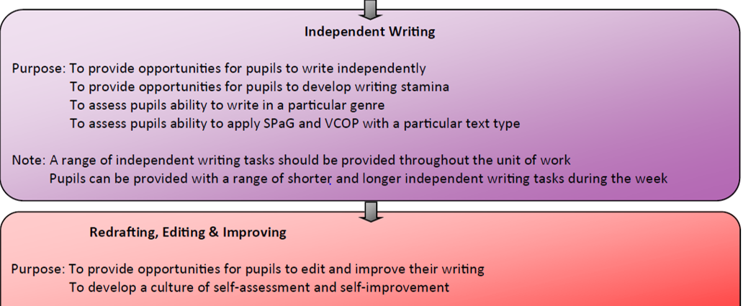
Morda Writing Pedagogy
WRITING A SUPPORTS/ SCAFFOLDS
Children use sound mats, spelling cards, vocabulary sheets, writing scaffolds, working walls and success criteria to support their independent writing at an appropriate level to their need ( except when writing for a formally assessed end of key stage pieces. )
REDRAFTING EDITING AND IMPROVING
Rec / Yr 1 improve their writing in pencil. Children from Yr 2 use green pen to edit their work and respond to marking. They are encouraged to become more independent in their improving and redrafting working with peers to improve each others writing as they move through KS2.
Note : Redrafting of writing is done where appropriate- e.g. redrafting a letter to send , redrafting a brochure on publisher for publication etc

Slide 14
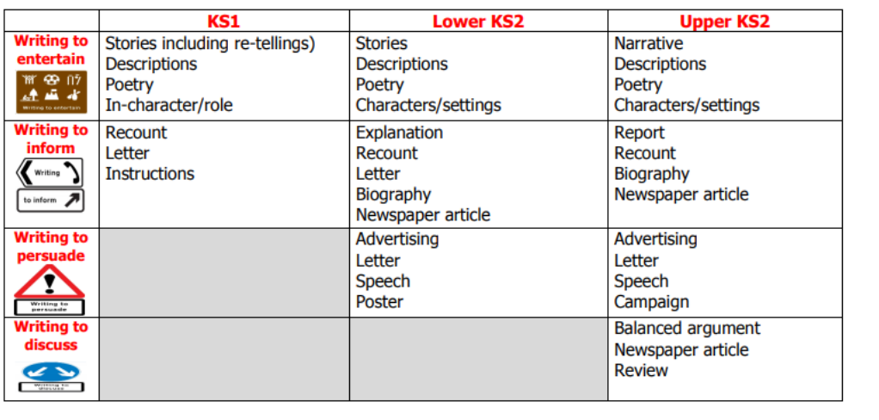
Genres
School has planned the genres to be covered across each year group and have added to National Curriculum requirements to reflect pupils’ needs
This is designed to ensure a sufficient balance between fiction and non-fiction genres, and enable teaching to be appropriately pitched to meet the needs of mixed-year groups
Teachers use the document to support their planning and agree genres with the writing subject lead in a pre-planning planning meeting each term to ensure appropriate coverage of the full range of genres.
Every term children are taught a short sequence of learning on communication writing (formal / informal letter or email) as part of their MoE context. This ensures the regular revisiting of this type of writing.
Narratives:
National Curriculum (Statutory):
Predictable and Patterned Language / Rhyming Stories (KS1)
Different Stories by Same Author (KS1)
Fairy Tales (KS1 / Y3/4)
Traditional Stories (KS1 / Y3/4 / Y5/6)
Play Scripts (Y3/4 / Y5/6)
Myths & Legends (Y3/4 / Y5/6)
Stories from Other Cultures (Y5/6)
Literacy Heritage / Classic Novels (Y5/6)
Modern Fiction (Y5/6)
School Curriculum (Non-Statutory):
Fantasy / Other World Stories
Stories from Other Cultures
Stories with Historical Settings
Fables
Adventure / Mystery Stories
Stories with Flashbacks
Local Stories / Authors
Other
Non-fiction:
School Curriculum (Non-Statutory):
Instructions
Formal / Informal Letters
Persuasive Writing
Information Texts
Recount Texts
Journalistic Texts / Newspapers
Explanation Texts (How/Why)
Discussion and Argument
Auto-biographies
Biographies
Dictionary Work
Other
Poetry:
National Curriculum (Statutory):
Reading Poetry
Reciting Poetry ‘by heart’
Performance Poetry
School Curriculum (Non-Statutory):
Nursery Rhymes
Using Pattern and Rhyme
Exploring Form
Narrative Poetry
Other

Slide 15
Summative Assessment of writing
Each half term, teaching staff assess 2 pieces of writing against the Morda Writing Assessment Grids . Staff report the progress and attainment of individual pupils once a term based on the outcomes.
12 pieces of work will be assessed over the course of a year - teaching staff complete a writing assessment and use this assessment to help inform future writing targets .
For children in Y2 and Y6, the Interim Writing Assessment Framework (“grids”) should be used in terms 2 and 3 to record the outcomes of assessments.
The assessed writing will be assessed using these resources above. Teachers and the subject leader agree the writing level recorded on to the school’s internal tracking system after internal moderation.
End of key stage assessment judgements are moderated with the writing lead and at joint school moderations sessions – ideally with an experienced county moderator present
Marking of Writing should inform the children of the next steps to improve their work, providing a positive comment and a way to improve their work informed by the success criteria for that particular sequence of learning. Success criteria are in informed by individual and class writing targets from the half termly assessments .

Slide 16
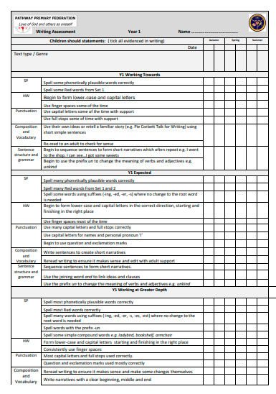


Slide 17
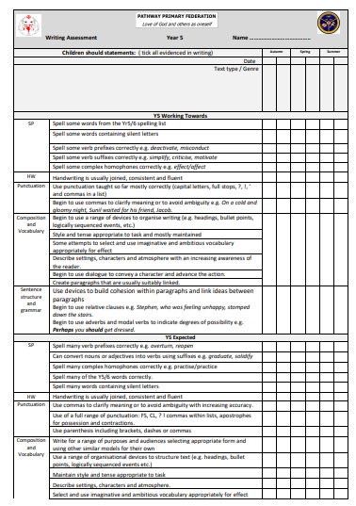
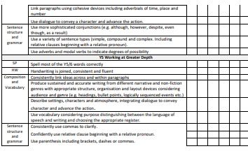

Slide 18
Moderation of writing
Moderation of writing occurs termly within school School will ensure external moderation takes place at least once a year and always for
Yr 2 and Yr 6 end of key stage assessments
School engages within moderation exercises with EIP schools
Inter-school moderation was disrupted due to Covid-19 in 2020-21

Slide 19
Formative assessment and pupil feedback
Questioning
A range of day-to-day questioning techniques are implemented to probe and check for understanding with feedback to the responses provided
Use of AFL and retrieval practise techniques
In-lesson Feedback
Written or Verbal Feedback is provided as much as possible during each lesson to provide instant feedback which children can act upon immediately: e.g teacher asks child to read out the sentence they have written – verbal feedback and changes made in the moment/ teacher TA moves around class reading texts and giving feedback as to how writing might be improved Teachers to encourage Teaching Assistants to provide in-lesson feedback to maximise feedback opportunities.
Self and Peer improvements
Children are taught to use Success criteria and improve their own writing by referring to the check list
Children in upper KS2 are taught to support each other with peer marking/ improving using the success criteria to help them
Green Pen Improvements and Redrafting
Children make improvements in green pen so their improvements can be easily seen
Children are encouraged to redraft some ‘best pieces of work’ for publication or display , or if the gnre requires it : e.g Newspaper report – finished report

Slide 20
Formative assessment and pupil feedback
Written Feedback – Extended Writing
Extended Writing tasks are marked through written feedback (at least once per week or two weeks if extended writing )
Key spelling, punctuation and grammatical errors are marked according to the marking policy. Marking should be responded to and corrected in R and R time.
1 positive comment should be provided which identifies and celebrates the effort of the pupil
Any improvement comments should also be provided which identify the next steps that a pupil needs to focus on to up-level and improve their work. ( This could be verbal)

Slide 21
The assessment of grammar, punctuation and spelling & handwriting
In the Early Years Foundation Stage and Year 1 the assessment of grammar, spelling and punctuation is achieved through
Speaking and listening activities
Progress through RWI
Formative and summative assessment of the mastery of early writing skills including curriculum expectations for grammar and punctuation
From Years 2 to 6, the assessment of grammar, spelling and punctuation is achieved through:
Formative and summative assessment of the mastery of writing skills including curriculum expectations for grammar and punctuation
The completion of spelling, activities through RWI Oxford Owl programme.
Yr 6 use CPG ten minute SATS Buster Books for Grammar assessment
Results are tracked on the appropriate age-related assessment grid. Children are taught in differentiated groups according to their ability; however, the opportunity for children to become familiar with their year group expectations is important.
Yr2 and Yr 6 work towards the national end of key stage grammar Spelling and punctuation tests using a range of support materials

Slide 22
Handwriting
The Nelson handwriting style has now been adopted across the school and pupils should be encouraged to develop a consistent handwriting style. If the letter finishes on the left hand side, the letter will not be joined e.g. j, y, etc.
Handwriting practice will be carried out every day in KS1 and for at least 1 days a week in lower KS2 for 10minutes at a time. In upper KS2 children identified as needing additional handwriting practise will have handwriting intervention in assembly times. Teachers should model the handwriting on the Nelson scheme
In Reception and Year 1 pupils will practice their mark making and handwriting every day. These pupils should focus on their individual letter formations and begin to join diagraphs and tri-graphs.
In Year 2 and KS2, pupils will practice their cursive handwriting of individual words, phrases or sentences taken from the Nelson Handwriting Books found on the School’s server or using their weekly spelling words.
Any marking of handwriting should be during the activity with a simple tick if complete accurately and circle errors made while providing verbal feedback for the pupils to improve e.g. ascenders/descenders, gaps between words, joined/un-joined letters, size, etc.
If pupils are not making the necessary progress with their handwriting from these sessions, then intervention should be provided in school using a more Cursive style ( Early morning Yr 4 writing intervention/ Yr 5/6 handwriting intervention )

Slide 23
Preparing children for the next steps
Discussions to take place with Marches School in Oswestry, regarding end points in writing and expectations for transition

Slide 24
Staff CPD & Research
All teachers have received writing CPD in house to develop understanding about Pedagogy, Writing Process, SPaG & Assessment
Range of external CPD attended which has developed staff knowledge e.g. Pie Corbet Talk for Writing, Alan Peat Sentence Types Etc.
School now using Jane Constantine The Write Stuff training materials to strengthen writing teaching
HC ex KS2 county moderator
Year 6 Teacher now working with Whittington Subject Leaders on ensuring standards are met and moderation
School has regularly engaged in cluster moderation with other schools in the area to ensure accuracy of assessment and to raise standards, inc. development of Interim Year Group Tick Sheets (Y1, 3, 4 & 5) However the Covid restrictions have meant this work has been suspended for the past 2 years.
2025-2026 Writing SDP focus – shared CPD – PD day / moderation/ implementing new assessments

Slide 25
How will this subject develop in the future?
Improve Spelling teaching – introduction MUST HAVE spellings in each year group
Consider new scheme

