Slide 1
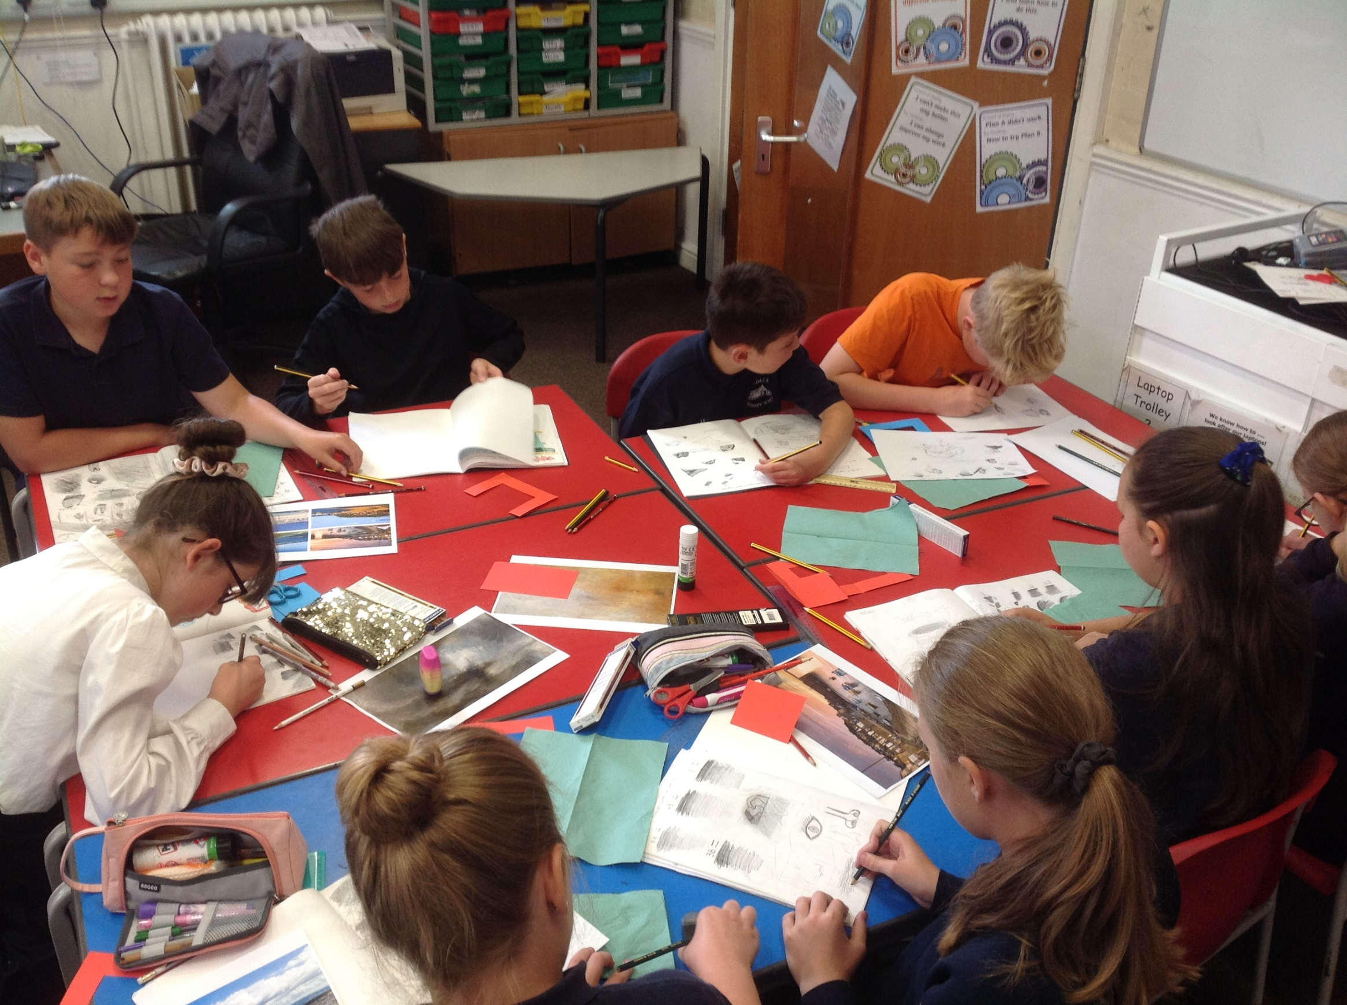
Art and Design
at
Morda Primary School
Subject Overview
and Plan
February 2022

Slide 2
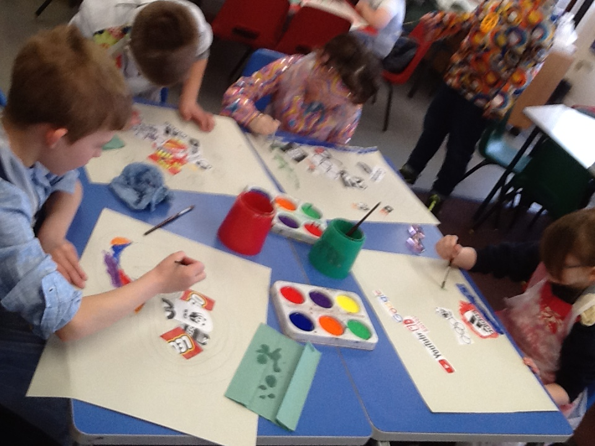
Overview
The design of the art curriculum
What we are trying to achieve with the art curriculum
Our aims for the teaching of art
EYFS Expressive Art and Design teaching and endpoints
Schemes of work followed and medium term planning in art
How art is taught
How we ensure that subject knowledge is retained
How children progress in art over their time at the school (Remembering that progress is knowing more, remembering more and being able to do more)
How we ensure that pupils with SEND benefit from the curriculum in this subject
Links to other curriculum subjects
Subject resources
What art teaching looks like in work and in lessons
How we prepare children for the next steps in their learning
How we would look to develop this subject in the future

Slide 3
Intent
At Morda Primary school, we believe art and design to be an essential part of the curriculum. Art allows the child to develop their imagination and creativity, to make connections through their inventive minds and gives children the skills to record their imagination and ideas. Art also encourages expression and visual thinking, which in turn helps children learn other subjects. Children can develop their observational skills through art and design, which helps children become better observers to the world around them. Children experiment with the use of colour, texture, form, line, shape, pattern and use different materials. The children learn to improve their mastery of art and design techniques by learning specific drawing, painting, printing, and sculpture techniques. The children use technology to produce images, patterns, and decorative pieces of work. They will record their observations and ideas and use them to review and evaluate improvements. They take inspiration from nature, design and will also learn about great artists, architects, and designers in history.

Slide 4
Curriculum and implementation
Our curriculum at Morda ensures that learning within art and design stimulates creativity and imagination. It provides visual, tactile and sensory experiences. Our rolling programme will inspire, engage and challenge children - enabling all pupils to communicate what they see, feel and think through the use of colour, texture, form and pattern. Pupils at Morda will become involved in shaping their environment through art and design activities, involving different creative techniques. They will explore ideas and meaning through the work of modern, contemporary and traditional artists and designers .

Slide 5
Our aims for the teaching of art
For children to develop their procedural and substantive knowledge in relation to primary art in order for them to make progress by knowing more, remembering more and being able to do more
To develop inquisitive minds and instil children with a sense of awe and wonderment in relation to art
To encourage children to be respectful of art
For children to know the impact of art and encourage them to play their role as global citizens
For children to be ambitious and prepare them for the next step of their learning in art
For children to be resilient in seeking improvement and overcoming challenges in art

Slide 6
Impact
By the end of their time at Morda, we want pupils to have learned, improved and embedded a range of artistic skills. They should have an awareness of a broad range of artists and craftspeople, and be able to consider and discuss the artworks they come across. We want our pupils to be confident to explore, experiment and take risks, placing value on the process and journey that they take, not just on the finished product. Most importantly, we want children to have found and enjoyed a creative outlet – a means of self-expression and enjoyment.

Slide 7
EYFS Expressive Art and Design AT MORDA
Our indoor and outdoor area are set up so the children can explore and experience Art and Design in the continuous provision every day. Modelling takes place so the children know how to use paints, chalks and pastels.
Reception children follow the Bluebell’s Art planning and are exposed to a range of artists, paintings and techniques.
Children use the techniques learnt and practise during the continuous provision. They independently access a range of resources to produce art work they are proud of and share with others.

Slide 8
Early Learning Goals
At the end of the Reception year, children are assessed against the Early Learning Goals. Children are assessed as expected or emerging. Expressive Art and Design covers Art, Music and Dance.
This information is shared with parents and year 1 teachers so they understand the child’s stage of development and learning needs and help them to plan the year 1 curriculum to meet the needs of all children.
Expressive Arts and Design
Creating with Materials ELG
Children at the expected level of development will:
- Safely use and explore a variety of materials, tools and techniques, experimenting with colour, design, texture, form, and function;
- Share their creations, explaining the process they have used;
- Make use of props and materials when role playing characters in narratives and stories.
Being Imaginative and Expressive ELG
Children at the expected level of development will:
Invent, adapt and recount narratives and stories with peers and their teacher;
- Sing a range of well-known nursery rhymes and songs;
- Perform songs, rhymes, poems and stories with others, and
– when appropriate try to move in time with music.

Slide 9
The importance of art at Morda Primary School
Art, in its many forms, is practised by almost all human cultures and can be regarded as one of the defining characteristics of the human species.
Art in schools shouldn’t be side-lined… it should be right there right up in the front because I think art teaches you to deal with the world around you. It is the oxygen that makes all the other subjects breathe.
Alan Parker, filmmaker
Every child is an artist. The problem is how to remain an artist once he grows up." Pablo Picasso
"That's the great thing about art. Anybody can do it if you just believe. With practice, you can make great paintings" ​Damien Hurst

Slide 10
The design of the art curriculum
Planning follows National Curriculum
Four-year rolling programme in operation for art in KS1 and KS2 – the rolling programme ensures the following:
Match with two-year rolling programme for other subjects to provide cross-curricular links
Sufficient and cumulative coverage of the national curriculum components that develops knowledge over time (regardless of theme)
Components are tracked to ensure key components are taught and repeated throughout rolling programme – a ‘spiralling’ curriculum
Match to specific needs of learners at Morda, reflecting needs and characteristics of learners
Prevention of duplication of content due to fluctuation in year group sizes whilst enabling sufficient coverage and revisiting of key concepts
Time allocation for primary art is blocked each ½ term

Slide 11
Medium term planning in art
The school uses a commercial scheme of work (Teaching Primary Art and Design , Bloomsbury), to ensure a clear sequence of learning, however this is a basis for how we teach art and can be adapted and customised to ensure the following:
Children develop sufficient knowledge within the 4 class structure
The National Curriculum is taught
Children’s learning reflects their local context (opportunities and limitations)
Instead, components have been mapped on the rolling programme for art
Knowledge organisers set out the components to be developed which are also informed by the progression of knowledge document
These are used as a tool for teachers planning and sets out the specific content in a clear sequence to be taught and remembered in a unit of work

Slide 12
Key stage 1 programme of study
Pupils should be taught:
to use a range of materials creatively to design and make products
to use drawing, painting and sculpture to develop and share their ideas, experiences and imagination
to develop a wide range of art and design techniques in using colour, pattern, texture, line, shape, form and space
about the work of a range of artists, craft makers and designers, describing the differences and similarities between different practices and disciplines, and making links to their own work.

Slide 13
Key stage 2 programme of study
Pupils should be taught:
to develop their techniques, including their control and their use of materials, with creativity, experimentation and an increasing awareness of different kinds of art, craft and design.
Pupils should be taught:
to create sketch books to record their observations and use them to review and revisit ideas
to improve their mastery of art and design techniques, including drawing, painting and sculpture with a range of materials [for example, pencil, charcoal, paint, clay]
about great artists, architects and designers in history.

Slide 14
Components within art
Morda Primary School have set out components for children to learn and develop through art.
These deliberately repeat and use a variety of media
See Morda Art and Design progression of knowledge to see how components track across units
line, texture, colour, pattern, shape and space

Slide 15
Substantive practical knowledge in art
Drawing
Painting
Sculpture
Ceramics
Textiles
Photography
Collage
Craft
Printing
Graphic design
Installation art

Slide 16
Progression of art
Art pedagogy has been developed to support the development of children’s understanding and growing knowledge and skills
This ensures the continuation of key knowledge from simple to more complex concepts as children progress through the school
It also allows for teachers to focus on the key elements of two year groups in each class, no matter the year group split
See Morda Progression document for detail

Slide 17
In order to make progress, pupils need to develop:
Fluency
Experimentation
Authenticity

Slide 18
Sketchbooks
Sketch books provide a record of progression and the development of knowledge and skills learnt through a topic
Final pieces are not included in sketch books, but a sample of work is within a school portfolio and shown in various displays around the school.

Slide 19
How we select the artists and their work, that pupils study at Morda Primary School.
Morda Primary School have selected artists to develop children’s understanding and appreciation of diversity and the understanding of the different aspects of art and design. See two year rolling programme for artists.
This includes
Artists from different periods in history
Artists from traditions of different cultures and nationalities
British artists
Local artists
Artists from different backgrounds, gender, race, etc.
Children are beginning to be made aware of different artists from contemporary, modern and traditional – children are also made aware of this vocabulary.

Slide 20
Assessment of art
Children have opportunity to develop their increasing knowledge of art though their increasing skill
This is assessed through ongoing formative assessment.
This includes, although is not limited to, the following:
In-lesson feedback - discussions with children about their work (before, during and after practical work), providing support and intervention where needed during the lesson
Self-assessment
Peer-assessment
Brief summative assessments are made at the end of each unit to inform end of year reporting arrangements and subject self-evaluation

Slide 21
What do we mean by progress at Morda Primary School?
Substantive
Practical – knowledge about how we make art
Theoretical – knowledge of art and its history
Disciplinary
Disciplinary – knowledge of how quality and value have been expressed by experts

Slide 22
How we ensure that pupils with SEND benefit from the curriculum in this subject
Largely differentiation by outcome to ensure that there are no artificial limits to children’s knowledge and expression in art
Support through additional adults where appropriate
Adaptation of tasks/equipment where required
Any interventions are timetabled so that no child misses out on art and design lessons.

Slide 23
Links to other curriculum subjects
School will seek to make links to other curriculum subjects to
Develop children’s sense of time (looking at artists through history)
Develop children’s sense of place (looking at art and artists from a range of places)
Provide a context and a stimuli (physically and emotionally) to the art being produced

Slide 24
Subject resources
Morda Primary School follows a published scheme for art, Teaching Primary Art and Design (Bloomsbury) and uses it a basis for sequencing of learning
The school has a range of art materials in stock and will order specific materials when required.

Slide 25
Curriculum enrichment
The art curriculum is enriched through educational visits and visitors to support children’s knowledge of art
This includes
Visits to museums and galleries (Shrewsbury museum)
Local artist working within school to enhance art in school eg art club, art on display around the school

Slide 26
What art teaching looks like in work and in lessons
Art is included within the regular cycle of monitoring
This monitors outcomes in children sketchbooks and final pieces, reviews of planning and considers impact of assessment, practice and feedback (which next due for review in Spring/Summer 2022)
With subject lead, governors take part in ‘pupil voice’ activities to provide opportunity for children to reflect on their learning experiences (due in Spring 2022)
Link governors liaise with subject leaders to review curriculum developments and support evaluation. (To review in Spring 2022)

Slide 27
Preparing children for the next steps
Discussions to take place with Marches School in Oswestry, regarding end points in art and expectations for transition.
Art lead to work with classes with art lessons (Spring/Summer 2022)

Slide 28
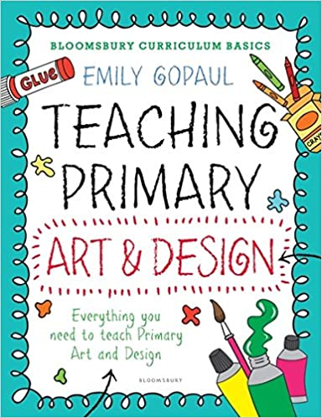
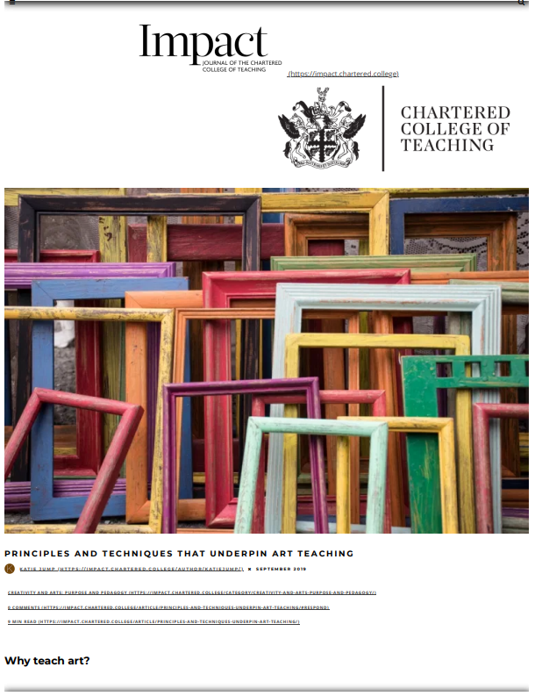
Staff CPD & Research
Morda Primary School have sought resources to support the development of the art scheme of work (Bloomsbury)
The school has developed the art curriculum using this resource. To review by subject lead in Spring/Summer term 2022.

Slide 29
How will this subject develop in the future?
To develop staff understanding of the pedagogy and concepts to be developed through primary art.
To allow children to become unique in their art work and to ensure children create authentic work which has been inspired by a selection of artists, not just a replica.
To complete monitoring in Spring 2021
To ensure pedagogy is embedded within classroom practice in art through team teaching with subject lead.

