Slide 1
September 2022
Presentation for parents on Phonics teaching at Morda

Slide 2
What are phonics?
The sounds (phonemes) represented by written letters.
https://www.youtube.com/watch?v=BqhXUW_v-1s
The link above shows how to articulate each sound.
In Reception/ Year 1 we concentrate on the sounds letters make and not the names.
We use the Read Write Inc scheme.

Slide 3
How do we use phonics?
We use phonics for early reading and writing.

Slide 4
Activity
Fred talk – we break the word up into sounds/ phonemes. (Fred is our Frog – he only talks in phonemes)
The words below are split into phonemes so we can FRED talk, blend it and then complete the action.
Put your hands on your h air
Put your hands on your t oe s
Put a finger on your ch i n
This game can be done in the car .. I’m going to FRED talk a word and you have to tell me what it is h a n d.
Or around the house… Put on your c oa t.

Slide 5
Here are some other examples for you to try..

Slide 6
c
a
n

Slide 7
p
i
n

Slide 8
Green words
c a t
m u m
u p

Slide 9
Some sounds (phonemes) have two letters one sound
ll
ss
ck
ff
sh
ch
th
nk
ng

Slide 10
h
i
ll

Slide 11
Red words / Tricky words
These are word that cannot be sounded out and blended – we learn them as red words to recognise on sight.
t h e
l i k e
t h e y

Slide 12
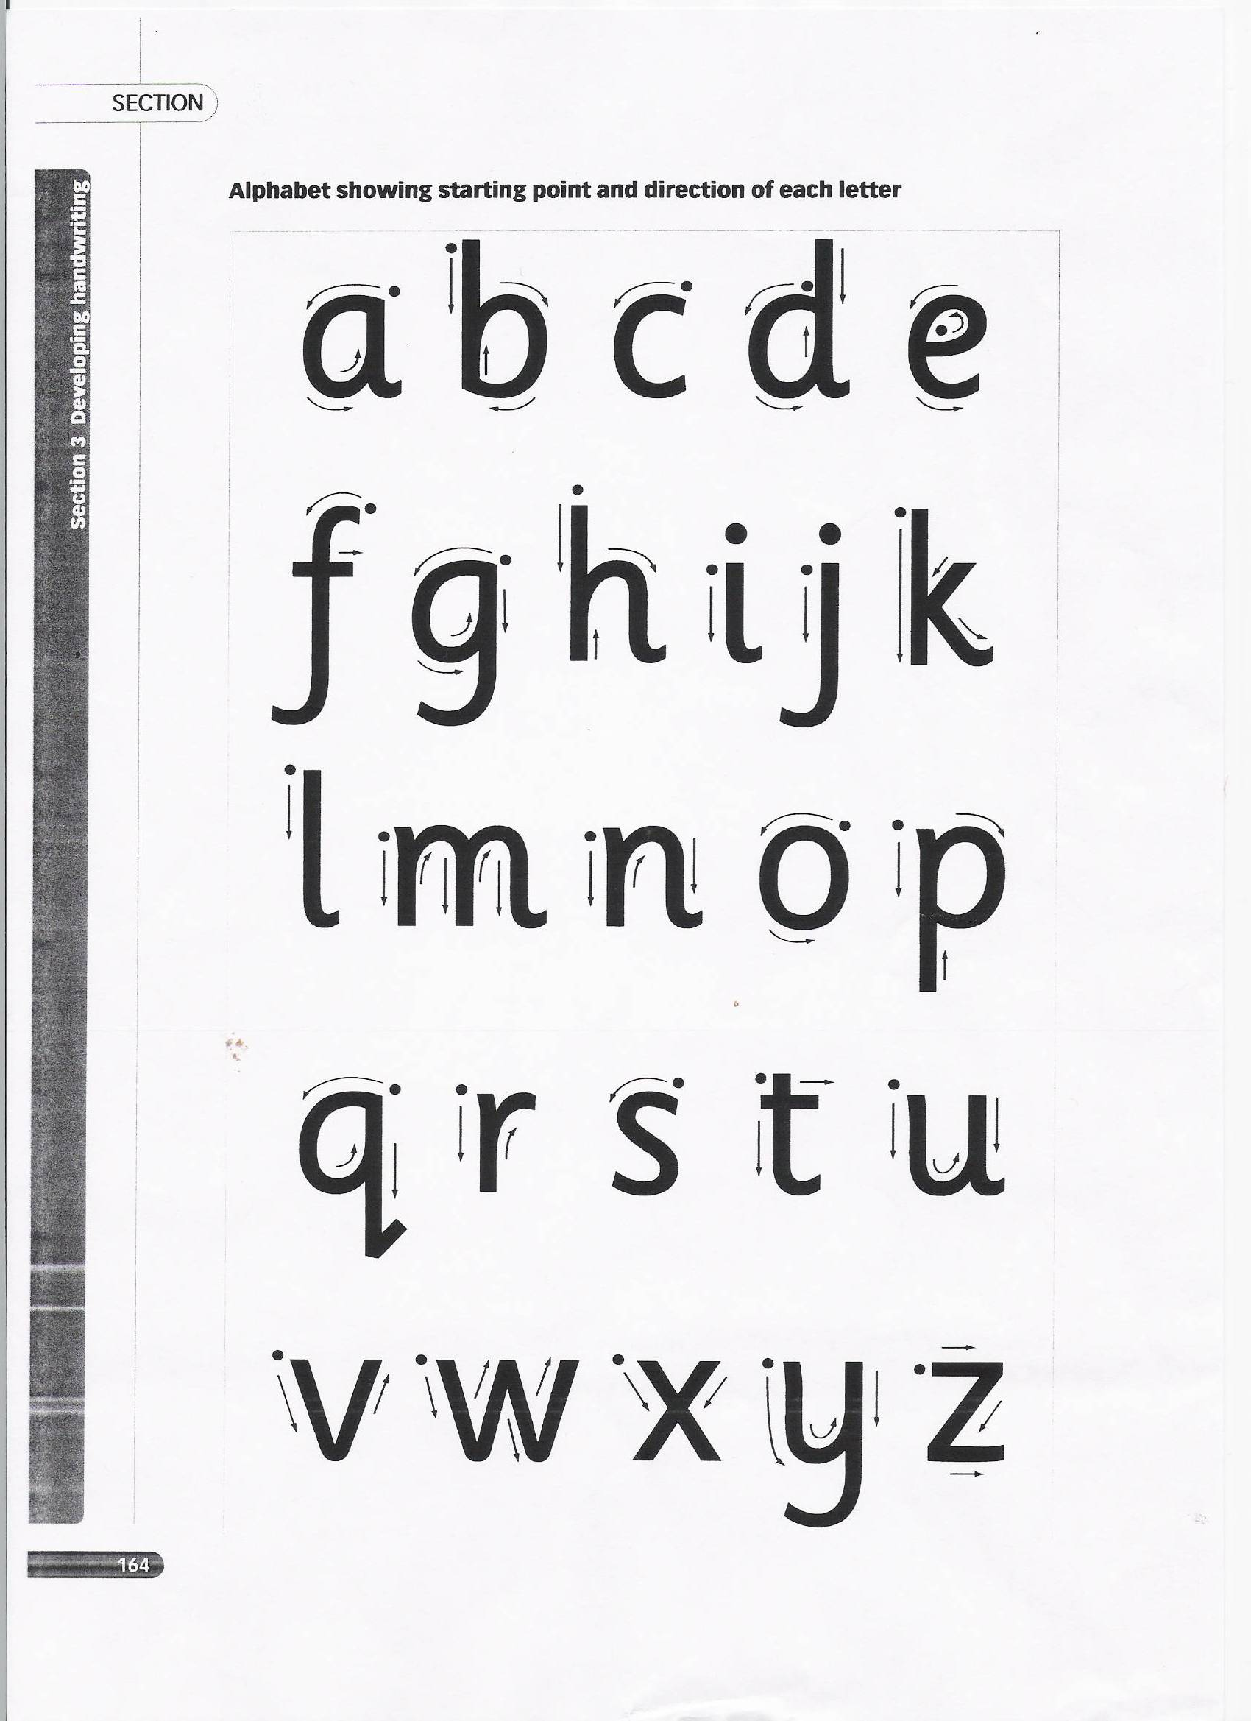
This is showing correct letter formation

Slide 13
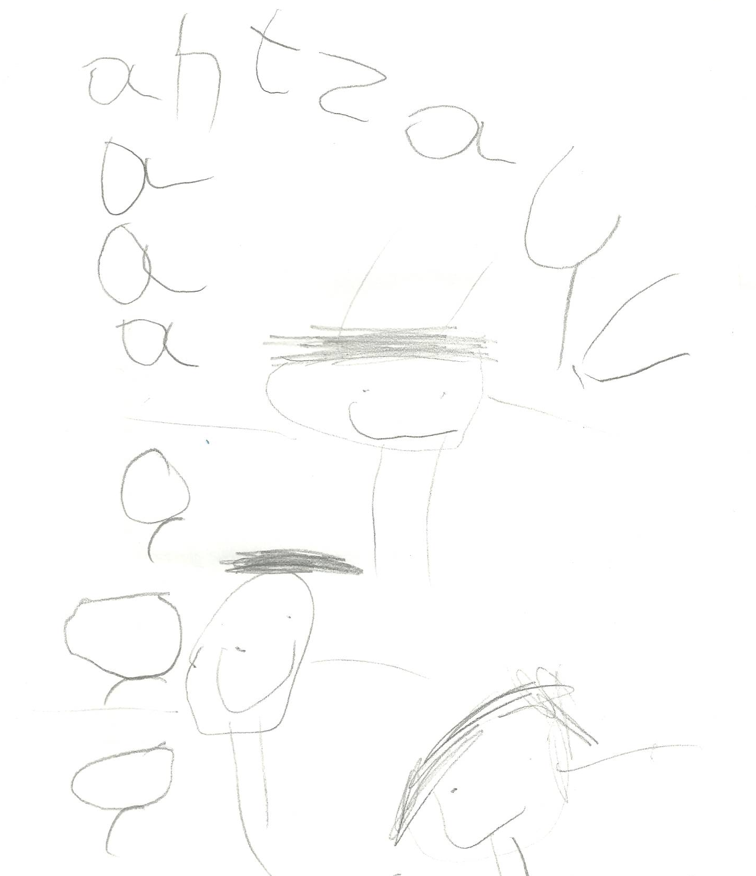
Reading in Reception will begin as marks and letters.

Slide 14
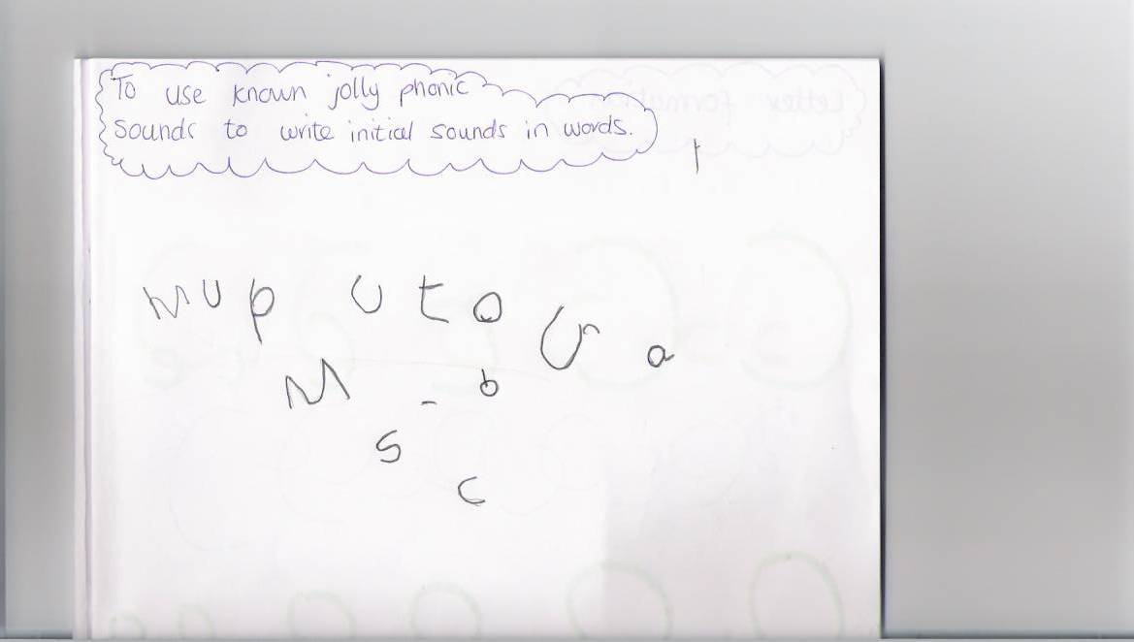
Children will then begin to sound out and write words.

Slide 15
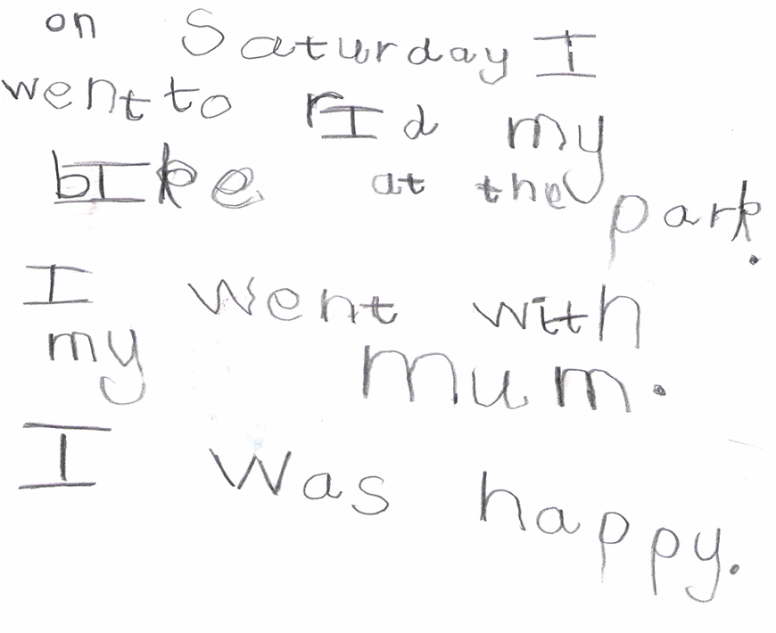
Eventually, they will begin to write sentences – to begin with phonically then spelling correctly by learning spelling patterns.

Slide 16
Now over to you.
Ask your child to get things like their c oa t or put their j u m p er on. They could try and Fred talk to you too like please can I have a d r i nk?
Your child will also be bringing home a phonics reading book and an enjoyment book. Time spent enjoying both is the only work we send home and is really beneficial to learning
www.oxfordowl.co.uk/ Parental advice and free resources.
Youtube articulation of phonemes (letters and sounds)

Slide 17
Thank you for your continued support.
Please do not hesitate to ask a member of the Bluebell team for any support.

