Slide 1

Mathematics
Subject Overview and Plan
Last updated – February 2022

Slide 2
Overview
The design of the mathematics curriculum
What we are trying to achieve with the mathematics curriculum
Our aims for the teaching of mathematics
EYFS Maths teaching and endpoints
Schemes of work followed and medium term planning in Mathematics
How mathematics is taught
How we ensure that subject knowledge is retained
How children progress in mathematics over their time at the school (Remembering that progress is knowing more, remembering more and being able to do more)
How we ensure that pupils with SEND benefit from the curriculum in this subject
Links to other curriculum subjects
Subject resources
What mathematics teaching looks like in work and in lessons
How we prepare children for the next steps in their learning
How we would look to develop this subject in the future

Slide 3
The rationale and intent behind our mathematics curriculum at Morda
INTENT:
At Morda, our vision is to foster a love for mathematics and to develop pupils who are confident and resilient when faced with mathematical challenges. We aim to create pupils who are fluent mathematicians who can problem solve and reason confidently. We want children to become adept at tackling number operations on paper, but who are also confident at mental arithmetic and have a quick recall of number facts. At Morda, children are made aware of the everyday purposes of maths and how the skills are essential and necessary in the real world beyond school.

Slide 4
Implementation
Through our Mastery based approach, pupils establish a deep and thorough understanding of number. Each mathematical operation is represented first by physical apparatus, then by pictures and diagrams and finally by abstract mathematical symbols. Children work together at broadly the same pace, supporting each other in their learning, showing compassion for others and the courage to “have a go”. This approach gives children the depth of understanding that they can then apply to new and unfamiliar mathematical problems.
They are taught to look for patterns, notice relationships, reason and explain in order to clarify their understanding. They are supported through carefully structured sequences of learning where each mathematical concept is built upon, step by step. Through carefully planned questioning, children’s mathematical understanding is deepened and expanded.
Children with SEND or who are struggling with maths are given targeted support to ensure they can make good progress. Children who quickly grasp and master mathematical concepts are given opportunities to deepen and extend their learning.
Children are taught to solve problems and ‘reason’ about maths through a planned daily teaching of reasoning.
​
Pupils are taught number and place value, addition and subtraction, multiplication and division, fractions, shape and space, data handling and measures systematically, and given regular opportunities to practise this procedural knowledge throughout the school. The school uses TT Rocks to support the teaching and learning of timetables in school and at home.

Slide 5
IMPACT
We work hard to ensure all pupils leave Morda with a good level of the mathematical substantive and procedural knowledge.
Morda pupils become eager mathematicians who enjoy a challenge.
Pupils leave Morda with the confidence and resilience to continue to embrace mathematical challenges at secondary school and with the ability to use their knowledge in real life situations.

Slide 6
Our aims for the teaching of Mathematics
For children to develop knowledge in relation to primary mathematics in order for them to make progress by knowing more, remembering more, to be able to do more
To develop inquisitive minds and instil children with a sense of awe and wonderment in relation to Mathematics
For children to be ambitious and prepare them for the next step of their learning in Mathematics
For children to be resilient in seeking improvement and overcoming challenges in Mathematics

Slide 7
Becoming Experts
To move from being a novice towards becoming an expert, pupils need a grounding in solid facts.
At Morda, these facts are practised and practised to develop automaticity and fluency.

Slide 8

Knowledge of methods
Our curriculum is sequenced so that pupils learn the most efficient mathematical methods and procedures.
WE ACHIEVE THIS BY FOLLOWING THE SEQUENCE OF LEARNING PROVIDED BY THE SINGAPORE “MATHS NO PROBLEM” SCHEME- see planning on website

Slide 9
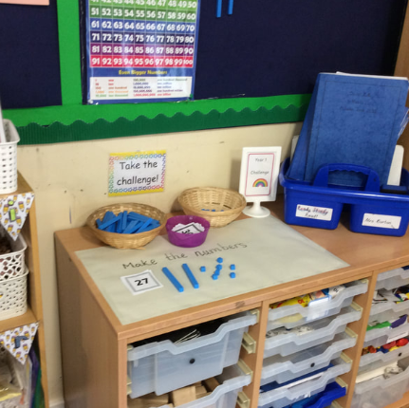
EYFS MATHS AT MORDA
At Morda we broadly follow the White Rose Maths.
From day one in school, children are exposed to incidental Maths. Children count the number of children in our class, record this information on tens frames and develop a love of numbers.
Each day, children have an adult led session of Maths and experience Maths in the continuous provision – both indoors and outdoors.
Children develop a deep understanding of numbers to 10 before moving on to larger numbers. They use part whole models, fives and tens frames and practical equipment to develop a secure understanding of the relationships between them and the patterns within those numbers.
Children experience larger numbers during our exercise brain breaks and count to 100 and in twos, fives and tens. They love knowing they can count to really high numbers!

Slide 10
Early Learning Goals
At the end of the Reception year, children are assessed against the Early Learning Goals. Children are assessed as expected or emerging.
This information is shared with parents and year 1 teachers so they understand the child’s stage of development and learning needs and help them to plan the year 1 curriculum to meet the needs of all children.
Mathematics
Number ELG
Children at the expected level of development will:
- Have a deep understanding of number to 10, including the composition of each number;
Subitise (recognise quantities without counting) up to 5;
- Automatically recall (without reference to rhymes, counting or other aids) number bonds up to 5 (including subtraction facts) and some number bonds to 10, including double facts.
Numerical Patterns ELG
Children at the expected level of development will:
Verbally count beyond 20, recognising the pattern of the counting system;
- Compare quantities up to 10 in different contexts, recognising when one quantity is greater than, less than or the same as the other quantity;
- Explore and represent patterns within numbers up to 10, including evens and odds, double facts and how quantities can be distributed equally.

Slide 11
The design of the Mathematics curriculum
The Singapore ‘Maths No Problem’ Scheme of Work for mathematics supports teachers in teaching for mastery where necessary within a mixed-year group context and ensures complete coverage of the 2014 Primary National Curriculum for Mathematics.
Work is supplemented with additional sources and teachers adapt and supplement this where/when necessary to fulfil the needs of particular cohorts, groups or individuals.
In particular, this is supplemented by NCETM, Maths Mastery resources and White Rose resources in KS1 and KS2 to ensure sufficient stretch and challenge within this subject.

Slide 12
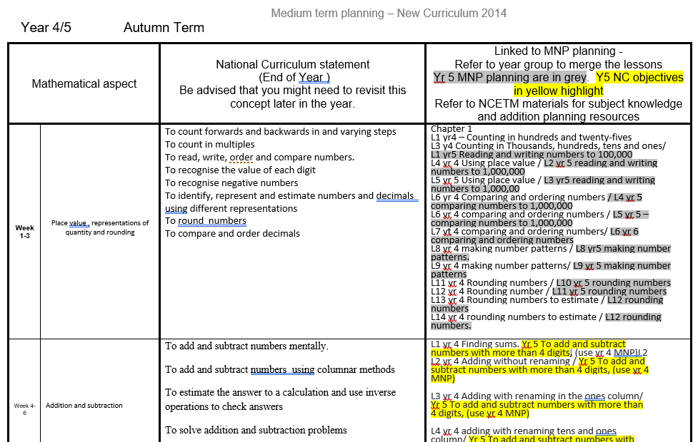
The design of the Mathematics curriculum
For some cohorts we have needed to use mixed age planning . With guidance from a Shropshire Maths Advisor, carefully planned Medium-Term overviews have been created for each mixed-age class, aligning year group objectives, ensuring that all areas of mathematics are taught and allowing pupils to build upon basic concepts to more complex ones.
Maths No Problem provides a clear structure for the delivery of mathematics from Year 1 to Year 6, allowing pupils to build upon prior knowledge by revisiting key mathematical concepts throughout the year. Early Years practitioners align the Early Years Mathematics Curriculum to the Year 1 Maths No Problem plans.

Slide 13
Medium term planning in mathematics
Each week contains 5 mathematics lessons.
Units are carefully structured to ensure continuity and progression, and that the amount of time dedicated to the different topics in the mathematics curriculum is sufficient and balanced.
Maths No Problem gives greater emphasis to certain mathematics topics, to ensure National Curriculum coverage, for example - number and place value, addition and subtraction, multiplication and division and, as and when appropriate, fractions, decimals, percentages, ratio and proportion.

Slide 14
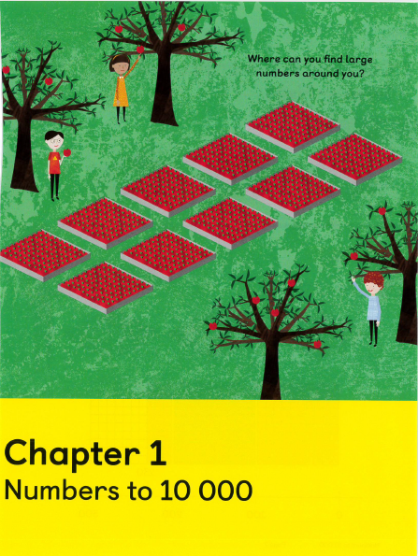
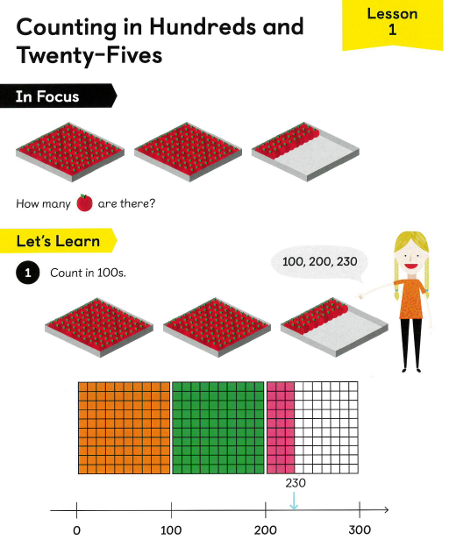
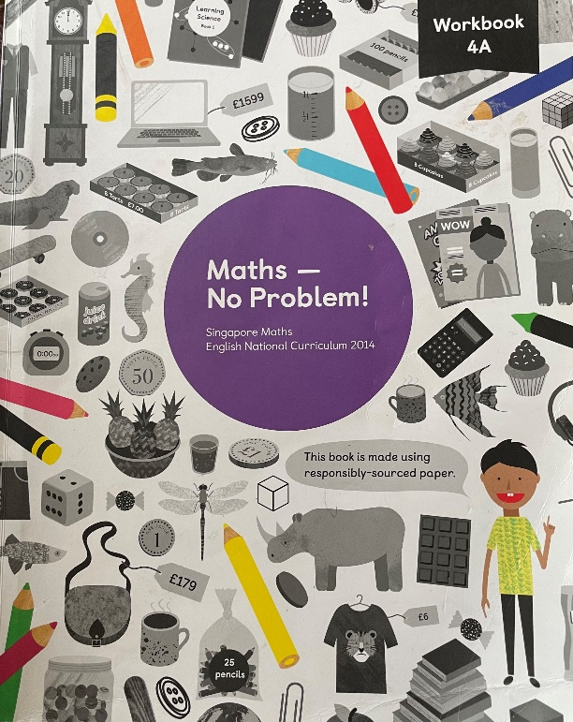
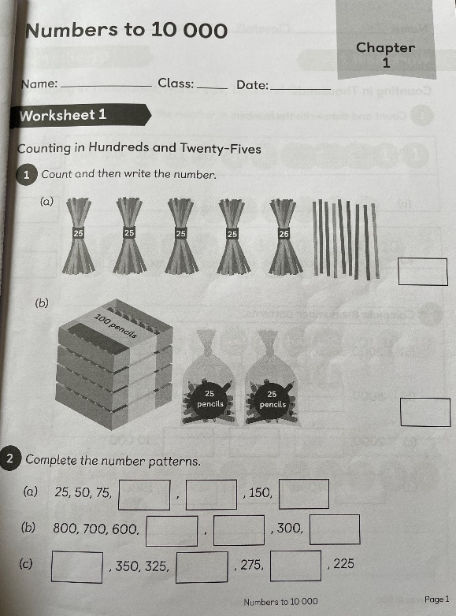
Resources
Maths No Problem is well resourced using high quality planning, activity books, pupil textbooks and Powerpoints.

Slide 15
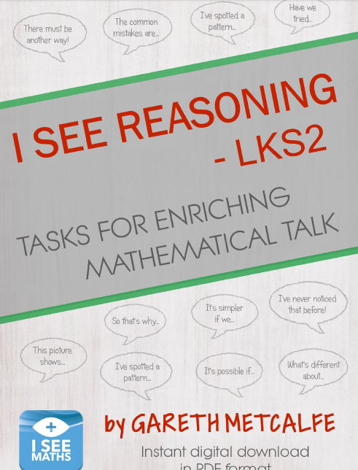
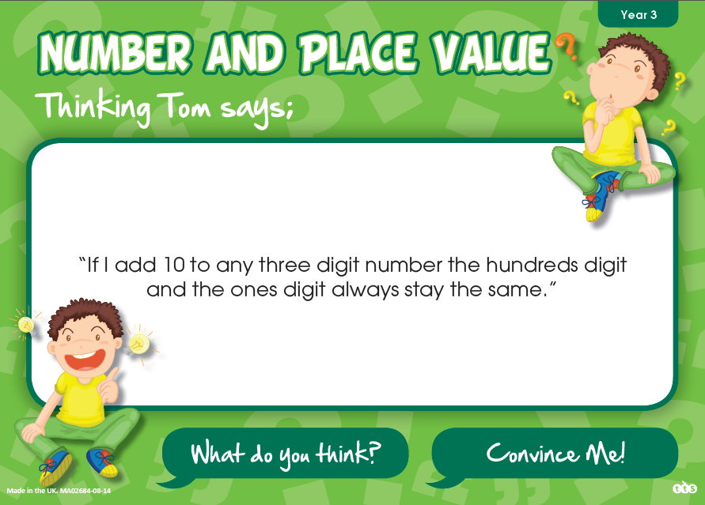

Other Resources
NCETM, White Rose and SHAWMaths HUB resources are used to enable teachers to challenge more able pupils by deepening their mathematical understanding and/or to support and further develop the understanding of those children who struggle and require more practise to embed mathematical concepts and skills.
The maths lead has designed a termly Reasoning Plan for all year groups – so a type of reasoning question is incorporated into daily lessons and practiced throughout the week so pupils recognise become confident with answering that type of question.
The teaching staff have access to a bank of Reasoning resources for each year group on the school server, which includes I See Reasoning, Convince Me cards, White Rose and NCETM.

Slide 16

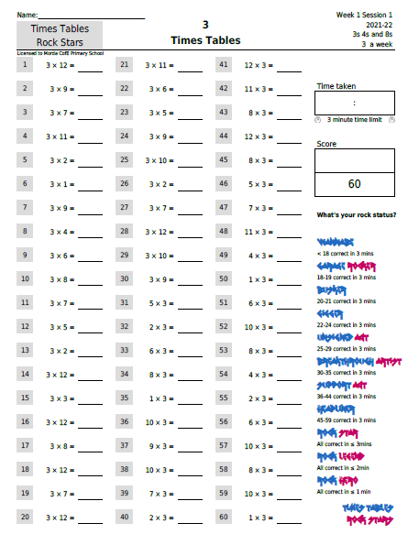
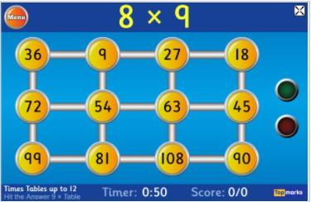
Resources – Times Tables
A range of resources are used to improve children’s ability to recall times tables facts:
Times Tables Rockstars
Interactive Games e.g. Hit the Button
Times Tables Workheets

Slide 17
DAILY NUMBER FACTS
Daily lesson include a starter which involves chanting and recalling key number facts / times tables – repeated over the week
Teachers then focus on the trickier facts that children typically find hard to learn
We use rhymes and actions to help children learn the trickier facts
We practise recalling number facts, orally and on “Show me” white boards
We then progress onto learning and practising the inverse
Extension – children progress to writing the calculation for a given answer

Slide 18
MORDA LESSONS INCLUDE:-
1) Daily Number Facts practice
2) POWERPOINT PRESENTATION (Maths No Problem)
3) Whiteboard AFL assessment opportunities using Walkthru techniques
4) Practise in books
5) Challenges are provided to enable children to work at a level appropriate for them, ensuring opportunities for rapid graspers to deepen their knowledge
5) Reasoning problem – question type repeated through the week, but on one day, last week’s reasoning problem is revisited

Slide 19
How we ensure that pupils with SEND benefit from the curriculum in this subject
Teachers make careful decisions as to which level(s) of challenge they ask individual pupils to complete
Some pupils with particular SEND in maths are taught in small groups at the appropriate year group level for their stage in mathematical development ( e.g 2021/2022 year 4 group taught year 3 objectives in small group 1-8 )
The level of questioning and scaffolding individual pupils receive in class as they work through problems will differ ( e.g use of mathematical apparatus Dienes / timetable squares to support teaching etc)
Children needing further support in mathematics will be provided with intervention sessions to revise basic facts and procedures linked to the week’s whole class work to develop their fluency
TAs are strategically deployed to support children struggling with maths to access the learning.

Slide 20
Assessment of Mathematics
Each term, teaching staff assess and record the progress and attainment of individual pupils. The outcome of the maths assessment is recorded without levels against end of year expectations.
Evidence towards that judgement, is drawn from the use of:
Children’s progress towards end of year expectations will be informed through the use of PUMA MATHS ASSESSMENTS and the work children produce
Children’s performance towards PCP targets (SEND)
Children’s performance in SATs (Y2 & Y6) and end of year assessments (Y1, Y3, Y4, Y5)
Children’s performance in end of unit assessments
Children’s performance in arithmetic tests ( Yr 5/6)
Children’s ability to recall times tables ( TTrocks and statutory Yr4 Multiplication check )

Slide 21
Ofsted – Mathematics Development Points (MAY 2019)
Improve leadership and management by ensuring that:
– teaching is consistently good or better across all year groups and in all subjects
– leaders make more rigorous checks on the initiatives they have introduced to improve the quality of teaching and learning ( SUBJECT LEADER DROPINS AND BOOK SCRUTINY SHOW TEACHING AND SCUTINISED BOOKS ARE GOOD – see class development points)
Improve the quality of teaching and learning so that pupils achieve as well as they can by ensuring that:
– in mathematics, pupils practise how to show reasoning skills in their work so that they deepen their understanding of mathematical concepts ( SUBJECT LEADER HAS PLANNED REASONING MEDIUM TERM PLANS FOR EACH YEAR GROUP- TEACHERS INCORERATING DAILY REASONING IN LESSONS)
– they increase the opportunities that pupils have to practise and refine their mathematical knowledge and skills through applying them in a range of subject areas across the curriculum
(SOME MATHS IN SCIENCE / DT and GEOGRAPHY- but remains a development area)

Slide 22
ASSESSMENT DATA SUMMER 2022
EYFS Local authority 77.8% Morda 80%
Year 2 SATS : Local Authority 64.4 Morda 67%
Year 4 Multiplication check 50% ( scored 20 and above)
Year 6 SATS: Morda 67%

Slide 23
What Mathematics teaching looks like in work and in lessons
Mathematics is included within the regular cycle of monitoring which includes learning walks, work scrutiny and pupil voice
Governors and management lead ‘pupil voice’ activities to provide opportunity for children to reflect on their learning experiences
Link governors liaise with subject leaders to review curriculum developments and support evaluation

Slide 24
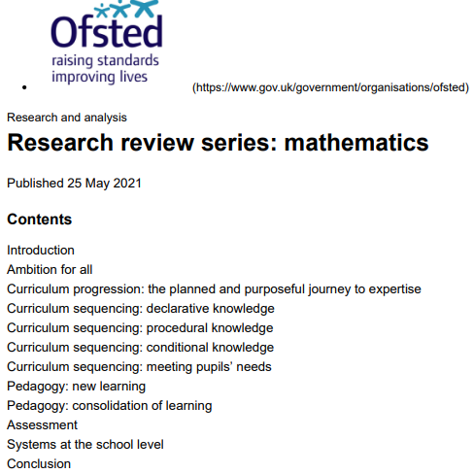
Staff CPD & Research
Staff have engaged in CPD to develop teaching of mathematics:
Maths Mastery Training
KS1 Moderation with local school
The school has used the latest educational research to inform the development of mathematics throughout the past few years
Ofsted Subject Overview – Di Pye training

Slide 25
Preparing children for the next steps
Mathematics is a focus of transition activity to support children’s transition to secondary school
The vast majority of children transfer to The Marches School in Oswestry - the school takes part in agreed transition units of work to support this process.

Slide 26
How will this subject develop in the future?
  Ensure development points from subject scrutiny is addressed
  Continue to develop Maths Mastery and Challenge Resources
  Adapt planning to single age range year group – where necessary
  Prepare Year 4s for the statutory MTC
  Engage parents further ( parents newsletter / workshops )

