Slide 1

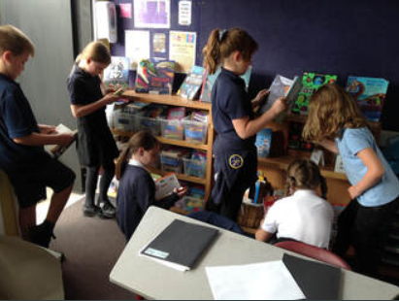
Reading
at
Morda Primary School
Subject Overview
and Plan
Last updated June 2022

Slide 2
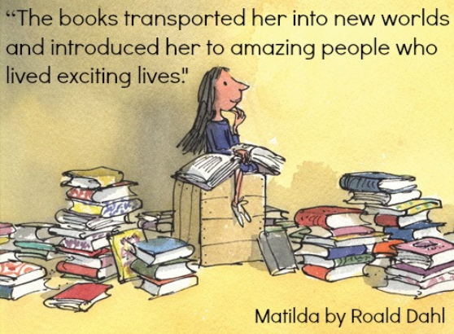
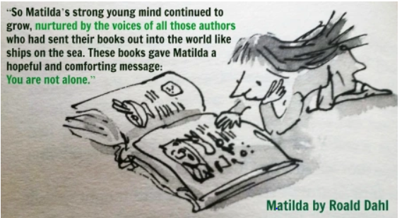
Why Reading is so important at Morda !

Slide 3
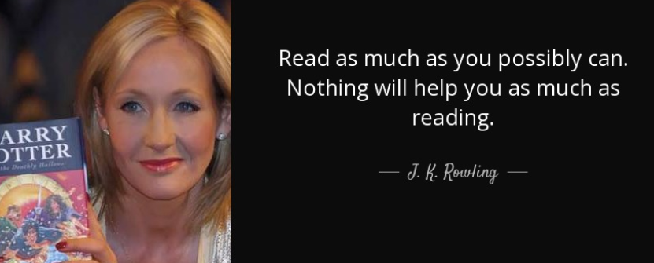

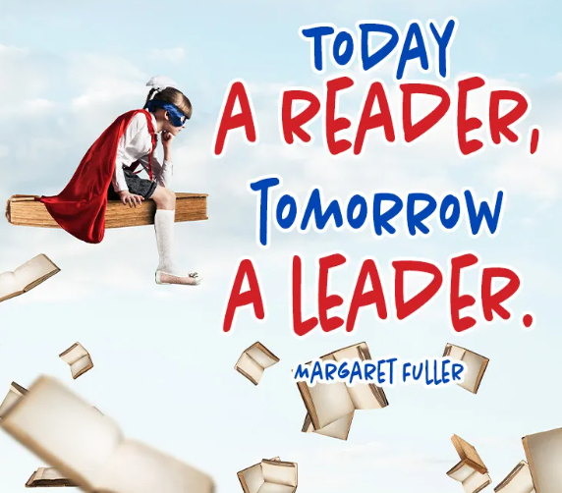


Slide 4

‘So please, oh please, we beg, we pray
Go throw your TV set away
And in its place you can install
A lovely bookshelf on the wall!’

Slide 5
Overview
Our aims for the teaching of reading
Morda Vision for Reading
The teaching of early reading and phonics
EYFS Reading at Morda
The teaching of reading after KS1
The assessment of reading
How children progress in reading over their time at the school
How we ensure that pupils with SEND benefit from the curriculum in this subject
Supporting children to develop a love of reading
Securing the engagement of parents
How we prepare children for the next steps in their learning
How we would look to develop reading in the future

Slide 6
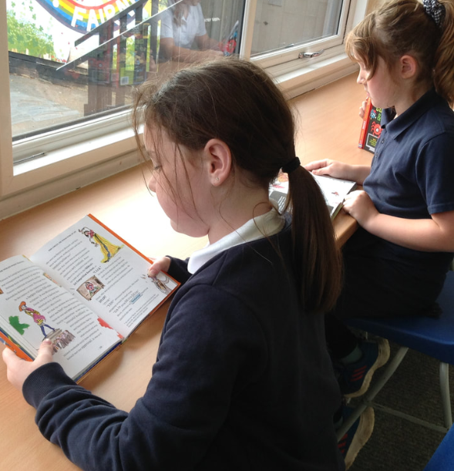
MORDA READING VISION
INTENT
At Morda reading is at the heart of the whole curriculum. We want all our pupils to become confident and reflective readers and develop a life-long love of reading. From the foundation stage onwards, Morda pupils are introduced to engaging high quality story, poem and non-fiction books which they share with their teachers and other adults in school and at home.

Slide 7
IMPLEMENTATION
Early talk is the critical first port of call on children’s Reading journey. By sharing wonderful stories from brilliant authors from day one at Morda, we are teaching children to imagine: especially those pupils with speech and language issues or other disadvantages.
Through carefully sequenced phonics and reading teaching and regular reading practice, pupils work to become fluent and expressive readers. Pupils successfully follow the Read, Write Inc phonics and reading scheme as soon as they start with us. Pupils begin by learning the phonetical sounds forming the basis of decoding words and sentences. In Guided Reading and Reading Mastery lessons pupils learn the skills to reflect on their reading. They develop comprehension, inference and evaluation skills and begin to analyse writer techniques. Pupils then use this knowledge to improve their writing.
Pupils are introduced to attractive engaging age appropriate reading books, as well as poetry, plays and non-fiction texts, which they use to aid their wider learning. They are guided and challenged in their choice of reading books and encouraged to read a wide range of genres, classic and modern texts. Books are chosen to represent a variety of cultures. The school’s book banding system helps pupils choose appropriately levelled books and our bookshelves are well stocked with engaging picture and information books for pupils’ enjoyment and pleasure.
SEND children in the school are given the bespoke support they need to reach their individual targets (catch up phonics, dyslexia tutoring and 1-1 additional reading ).

Slide 8
IMPACT
As we believe that reading is key to all learning, the impact of our reading curriculum goes beyond the result of statutory assessments. Children have the opportunity to enter the wide and varied magical worlds that reading opens up to them. As they develop their own interest in books, a deep love of literature across a range of genres, cultures and styles is enhanced.
Through the teaching of systematic phonics and reading enquiry, our aim is for children to become fluent and confident readers who can apply their knowledge and experience to a range of texts through the Key Stage 2 curriculum.
As a Year 6 reader, transitioning into secondary school, we aspire that children are fluent, confident and able readers, who can access a range of texts for pleasure and enjoyment, as well as use their reading skills to unlock learning and all areas of the curriculum. We firmly believe that reading is the key to all learning.
At Morda we work hard to ensure: parents and carers will have a good understanding of how they can support reading at home, and contribute regularly to home-school records; There will be no significant gaps in the progress of different groups of pupils (e.g. disadvantaged vs non-disadvantaged) and all children make good progress from their starting points.
Our pupils leave Morda influenced and inspired by the books they have read with the hunger to read more.

Slide 9
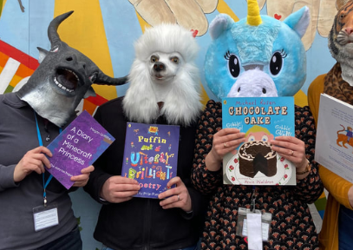
Our aims for the teaching of reading
For all children to develop healthy reading habits for life and a love of reading
To develop inquisitive minds and instil children with a sense of awe and wonderment in relation to reading
For children to be ambitious and prepare them for the next step of their learning in reading
For children to be resilient in seeking improvement and overcoming challenges in reading

Slide 10
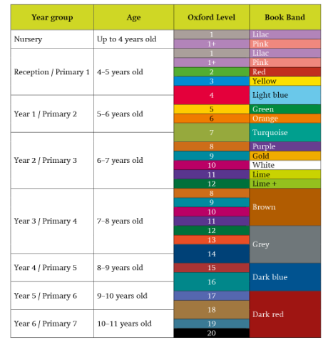
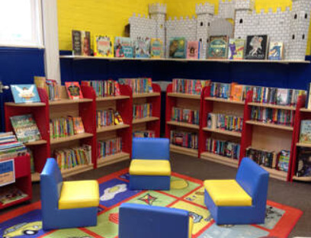
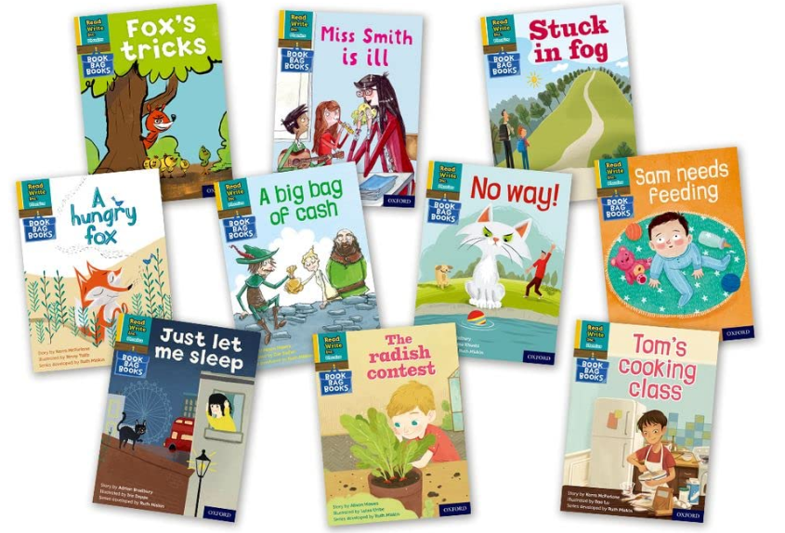
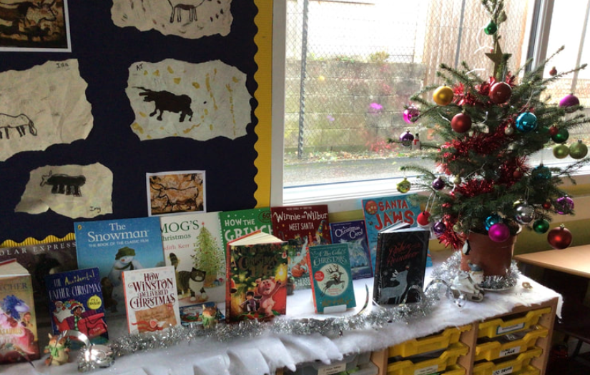
Progression of Reading
The school has a clear structure to the expected progression of reading at the school. This enables teachers to support children’s reading effectively, assess gaps and provide timely support.
Reading books connect closely to the taught phonics through the use of the ‘Read Write Inc’ scheme that the school uses
Once pupils complete the grey level of the Read Write Inc scheme they move onto the Oxford Reading tree colour banding which allows the teachers and parents to ensure that pupils are choosing appropriate books for their development
The whole school uses book banding to inform choice of independent reading book. The Reading Champion and class teachers monitor reading and support children to choose appropriate, books alongside recommendations from peers.
School has a excellent range of high quality non scheme reading books from a range of authors and genres in each class book area which are regularly updated and refreshed by the Reading Champion, library leaders and class teachers

Slide 11



The teaching of early reading and phonics
Phonics Scheme
Teaching of phonics in EYFS and KS1 is planned and resourced through the ‘Read Write Inc’ scheme.
A consistent 30 minute daily approach has been developed across EYFS and KS1.
KS2 children who have not sufficiently secured their phonics knowledge take part in ‘Fresh Start Phonics’ revision lessons (KS2 group 20 minutes 4x a week)
SEN children have individual PCPs and may have additional Dyslexia coaching ( Conquering literacy x 2 a week )
Less confident readers have additional reading with ‘Beanstalk’ and Reading.org volunteer readers and / or additional individual reading in class.
Reading Boost has been provided for Yr 2 children ( 2022) . Reading champion teaches an intervention 2x a week based on Reading Recovery.

Slide 12
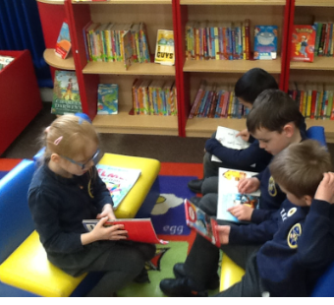
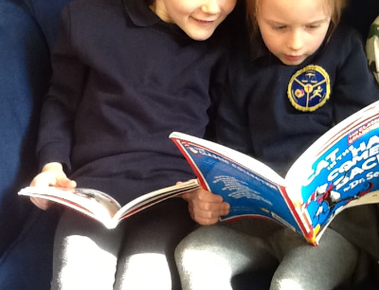
EYFS Reading AT MORDA
We want children to love reading from day one at school. We share books throughout the day and our indoor and outdoor areas are set up so the children have opportunities to access a range of books.
Children learn sounds within the first week of being in school which allows them to read words quickly.
Reception love to take on the role of the teacher during the continuous provision and read with Fred the frog.
Children vote for books they want to read and enjoy taking books to share at home.

Slide 13
Early Learning Goal
At the end of the Reception year, children are assessed against the Early Learning Goals. Children are assessed as expected or emerging.
This information is shared with parents and year 1 teachers so they understand the child’s stage of development and learning needs and help them to plan the year 1 curriculum to meet the needs of all children.
Literacy Comprehension ELG
Children at the expected level of development will:
Demonstrate understanding of what has been read to them by retelling stories and narratives using their own words and recently introduced vocabulary;
- Anticipate – where appropriate – key events in stories;
- Use and understand recently introduced vocabulary during discussions about stories, non-fiction, rhymes and poems and during role-play.
Word Reading ELG Children at the expected level of development will:
- Say a sound for each letter in the alphabet and at least 10 digraphs;
- Read words consistent with their phonic knowledge by sound-blending;
- Read aloud simple sentences and books that are consistent with their phonic knowledge, including some common exception words.

Slide 14

Story Time/ Reading Mastery
Every class has a class story or book that will be read to them by the teacher/teaching assistant during the week
This allows teachers to model reading regularly
It provides regular time for children to be read to throughout primary school and enjoy listening to stories, especially when children may not be read to at home
It provides opportunity for children to access stories that they might not be able to independently
It continues to promote a love of reading and an interest in books

Slide 15


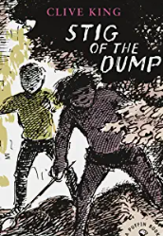

The teaching of reading – Shared reading and guided reading and Reading Mastery
EYFS and KS1 use Read Write Inc scheme for shared and guided reading
EYFS and KS1 also have daily sessions of sharing and discussion quality ‘real books’ from the class book area
On completing the RWI scheme upper KS1 children have guided reading / comprehension sessions using high quality age appropriate texts
KS2 children are taught reading comprehension using a Reading Mastery approach. Class teachers choose a quality age appropriate but challenging class novel and read together focussing on vocabulary, literal, inference , evaluation and prediction questions. Teachers base their questions on the year group subject progression documents
Class teachers also ensure children experience a range of non fiction/ poetry and playscripts in their Mastery Session .

Slide 16
READING MASTERY BOOKS 2021/22
DAFFODILS CLASS
AUTUMN : Reading mastery - non fiction - Ernest Shackleton's Journey - Shackleton's Journey
SPRING: Reading mastery - Dragon in the library Louis Stowell, The boy at the back of the class Onjali Rauf
Whole class book -The story of the Beatle
SUMMER
Whole class book - Oliver Twist (simplified version),
Reading mastery - The Street child Berlie Doherty
ROSES CLASS
AUTUMN: Stig of the Dump – Clive King; Non fiction : DK Find out Stone Age Poetry: Various Nature poems / WW1 poems – The Rain Maker Danced
SPRING : The Thieves of Ostia , Roman Mysteries – Caroline Lawrence Play Script: An Octopus in the bath- Ann Jungman Non Fiction : King Fisher Science Encyclopaedia- Materials and Technology
SUMMER: Anglo-Saxon Boy – Tony Bradman Non Fiction : Wild life Watchers Plants – Jerry Jennings Play Scripts – The Robot who went bananas – Ruth Dowley

Slide 17
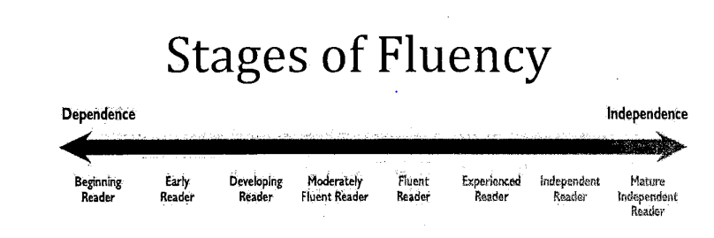
Assessment of reading
Each half term, teaching staff will report the progress and attainment of individual pupils.
The school has a Progression Document that is informed by the National Curriculum, Interim KS1 & KS2 Assessment Grids, Babcock Education and Renaissance Learning that teachers can refer to, to determine attainment against the end of year expectations for each year group.
This is based on the child’s:
Ability to decode print
Ability to ascribe meaning.
To inform this, assessment will take into account
Teacher’s formative assessment of children’s reading ability
the child’s performance in Pira Reading assessments ( Yr1-5)
the child’s performance in Fluency assessments (Rec- Yr 6)
The child’s performance in daily RWI sessions ( Rec-Yr2)
The child’s performance in half termly RWI summative assessments
the child’s performance in weekly mastery activities (Y3-Y6)
the child’s performance in formal standardised comprehension tests and exercises ( Yr 2 and Yr6 SATS papers).
To inform the interim teacher assessments judgements at the end of Key Stage 1 and 2, the school has cross-referenced these materials against the interim teacher assessment materials.

Slide 18
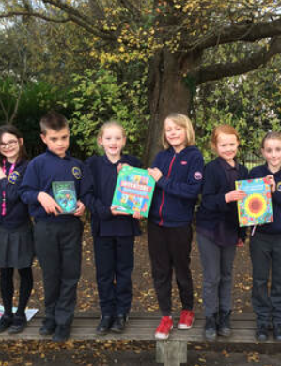
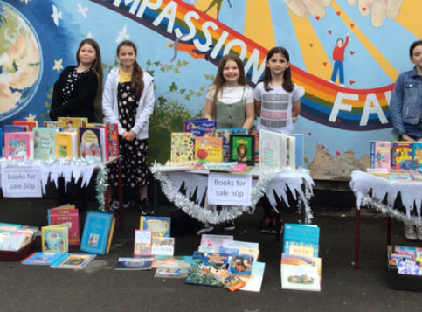

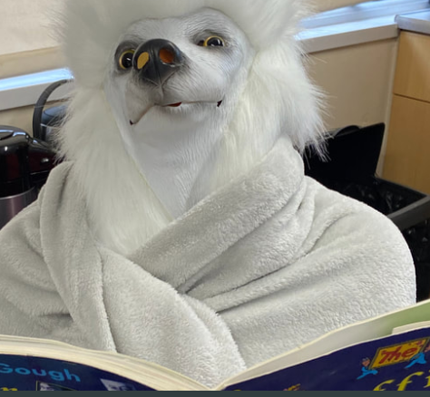
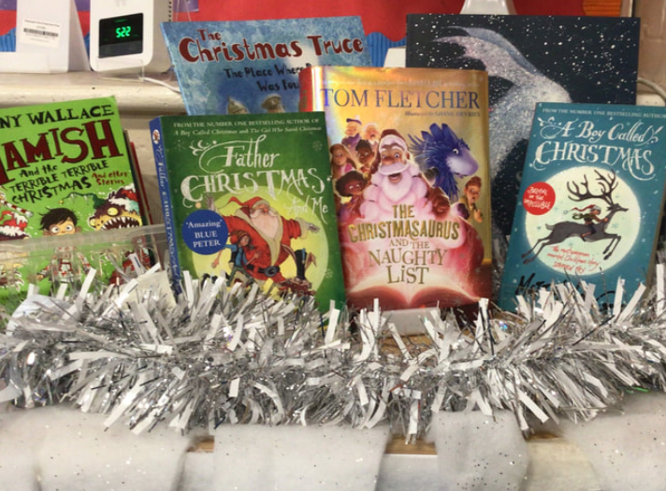
Reading Champion
Helen Jones, our Reading Champion, promotes Reading For Pleasure throughout the school.
She creates vibrant regularly changed themed book displays in key stage 2 classrooms.
Organises and encourages participation in reading competitions such as The Royal Society’s annual science book prize.
Organises and encourages participation in meet the author events (often in association with our local bookshop, Booka).
Organises and encourages participation in reading events – (e.g World Book Day – The Masked Reader/ book sales etc)
Manages the school library and classroom reading areas, with student library leaders .
Ensure KS2 children are on an appropriately banded reading book

Slide 19
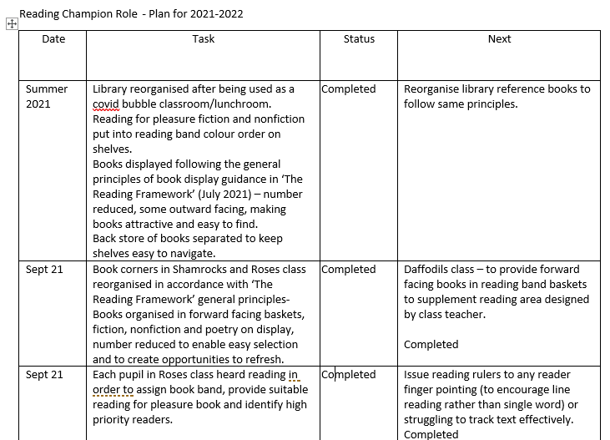
Reading Champion Role 2021/ 2022

Slide 20
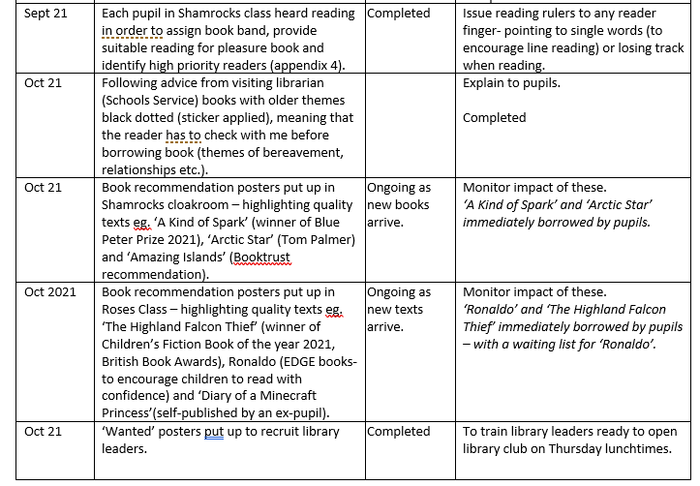

Slide 21
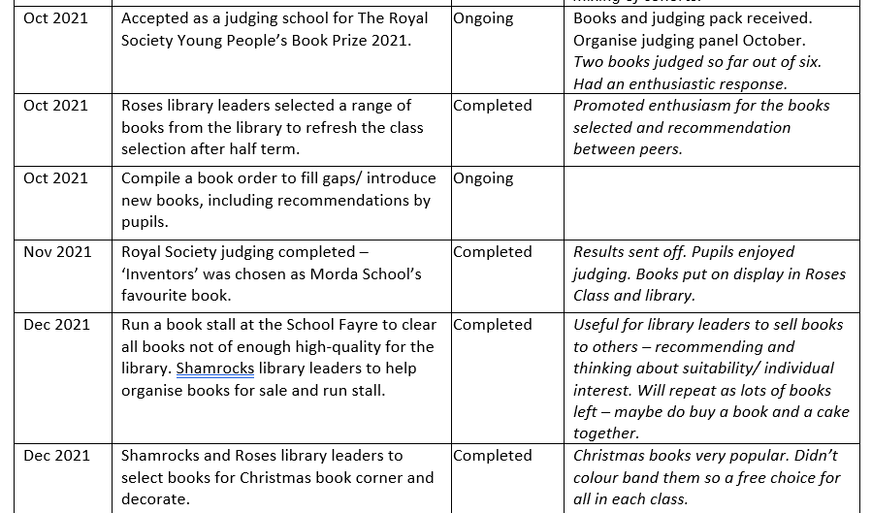

Slide 22
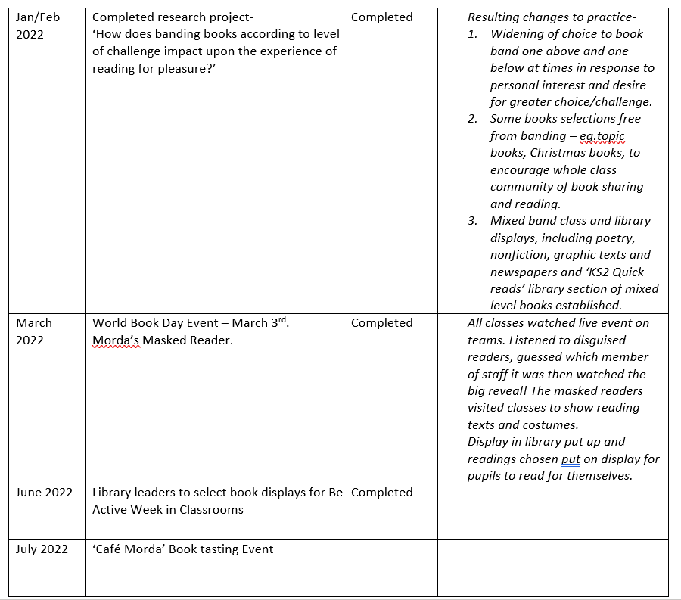

Slide 23
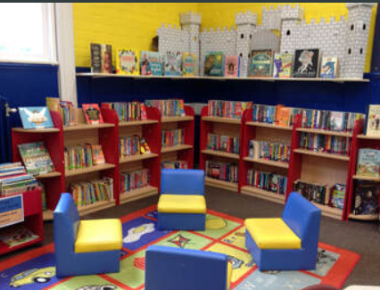
Libraries – ‘all about books’
Reading Champion has set up attractive book banded library
Library leaders help to organize books
In class book displays

Slide 24
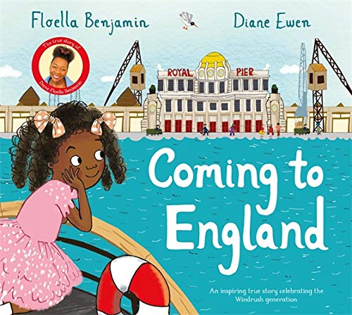

Author visits/ Book judging
Tom Fletcher 2019
Floella Benjamin (Coming Home) -2021
Konnie Huq (Cookie) – 2020
Lenny Henry 2021
During Lockdown Oak academy authors on line
Year 6 child self published a book and did
an author visit
Royal Society science books judging- STEM books in school

Slide 25
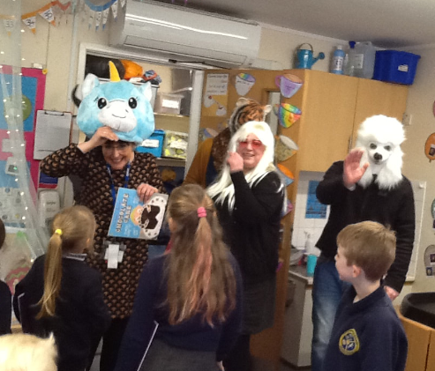

World Book Days
We hold a World Book Day every year
Children participate in a range of activities and events during the day which promote a love of reading and further interest in reading
This year ‘The Masked Reader Event’ – see website
A book fair /books sales termly

Slide 26
Tracking reading
EYFS and KS1 Read Write Inc Reading Tracker
Reading Records/Logs
Reading Champion Recommended Reads

Slide 27
Year 1 Phonics screening check
Phonics has improved since 2019 when we had 59% of children achieving.
Since then have spent money training staff, purchasing book banded books and having support from the RWI portal.
In 2020 even after lockdowns, we achieved a pass rate of 86%
In 2021, the pass rate was 73% with one child very close and one child with an EHCP.
In 2022, the pass rate was 93%
Measures have been put in place to make improvements and provide consistency across the school. We have children in year 1 having Fast track phonics and the Year 2 children who didn’t pass are having one to one sessions with a reading tutor.
2022 year 2 resits 3/4 children passed

Slide 28
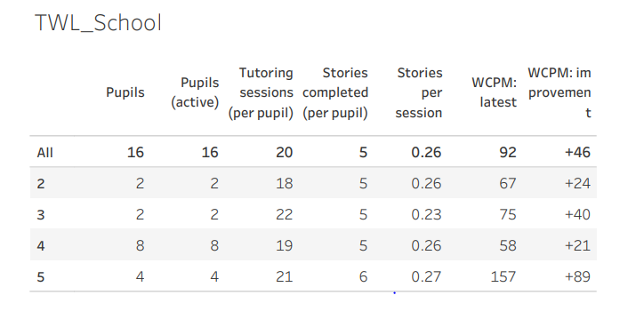
Covid Catch up
Catch up Fisher family Trust programme implemented
( Autumn 2021 ) 12 week programme- some progress
Catch up money used to employ a qualified teacher – working as a HLTA to provide RWI Catch up phonics programme for 6 SEN children in Year 4 who had not passed set 3 and 3 sounds
Catch up money used to employ additional Positive Leap Dyslexia Coach

Slide 29
Reading end of key stage
Teacher Assessments 2022
 |  | Morda | Shropshire | National
EYFS Word Reading | Expected and above | 80% | 75.9%
Year 1 Phonics | Expected and above | 92.3% | 75.4%
Key Stage 1 | Expected and above | 69% | 66.3%
Key Stage 2 | Expected and above | 53%

Slide 30
How children progress in reading during their time at Morda ( data here)

Slide 31
Internal data (minimising impact of Covid-19)

Slide 32
Parental engagement
Continual communication through Reading record books / Website
Parent Leaflets to support reading at home in KS1 – Bluebells and Daffodils
Reading Workshops for parents in Early Reading in Sep for new intake children

Slide 33
Preparing children for the next steps
Children leave school as independent readers who read for pleasure
Year 6 Reading transition talks with Marches School

Slide 34
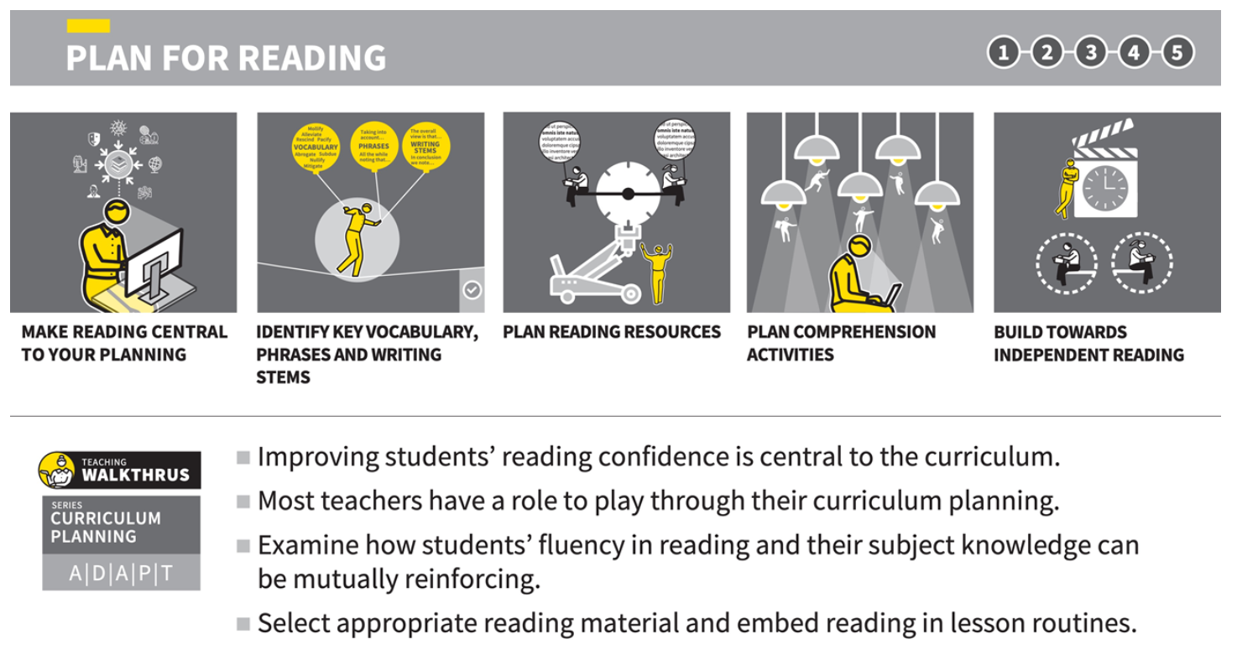
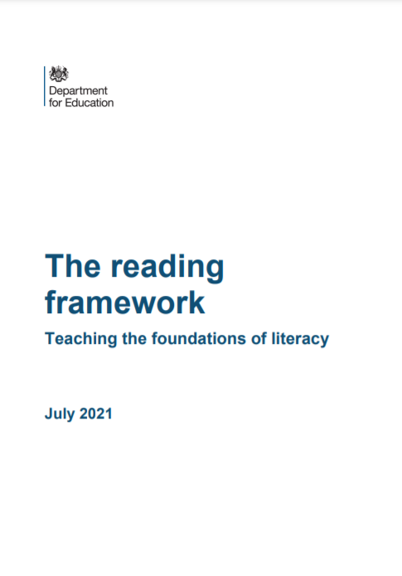
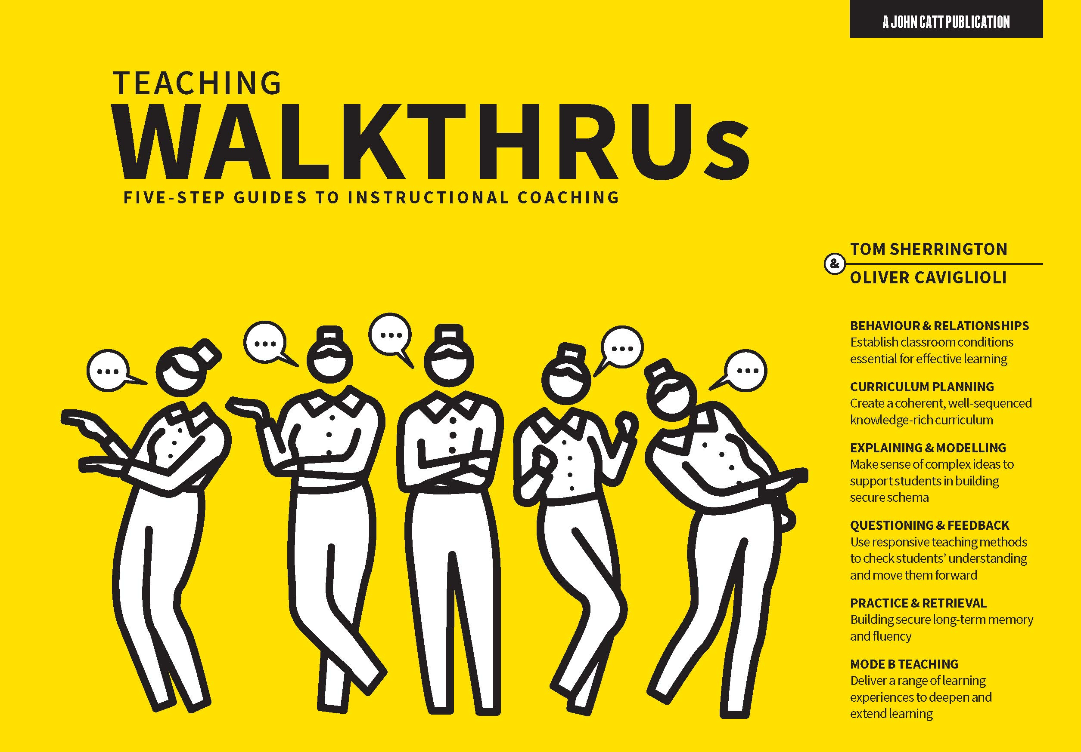
Staff CPD & Research
All KS1 staff received phonics training RWI
The Reading Framework has been used to audit and make further improvements in Early Reading in EYFS
Teaching Walkthrus – Plan for Reading – to incorporate reading within teaching and learning activities across the curriculum

Slide 35
How will this subject develop in the future?
  End of key stage reading results to be in line with National and Shropshire by summer 2023
  Improving parental engagement in reading in key stage 2
  More author events

